Slide 1
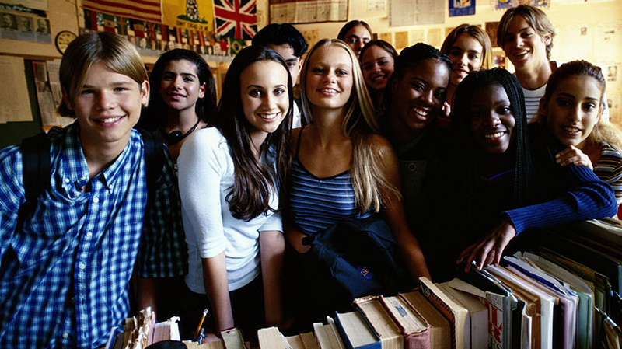
The Changing Face of Bellevue
Latest Information on Bellevue’s Demographics September 2016
Department of Planning & Community Development

Slide 2
Outline
What is driving Bellevue’s population growth?
How is growth affecting Bellevue’s demographics?
How are demographic changes affecting the built environment and need for services?
How can we anticipate the needs of our changing population?

Slide 3
What drives population growth?
Convenient access to:
Jobs
Goods and services
Multiple transportation options
Parks, nature and open space
Good schools
Affordable housing
Source: City of Bellevue Department of Planning and Community Development and Washington State Office of Financial Management

Slide 4
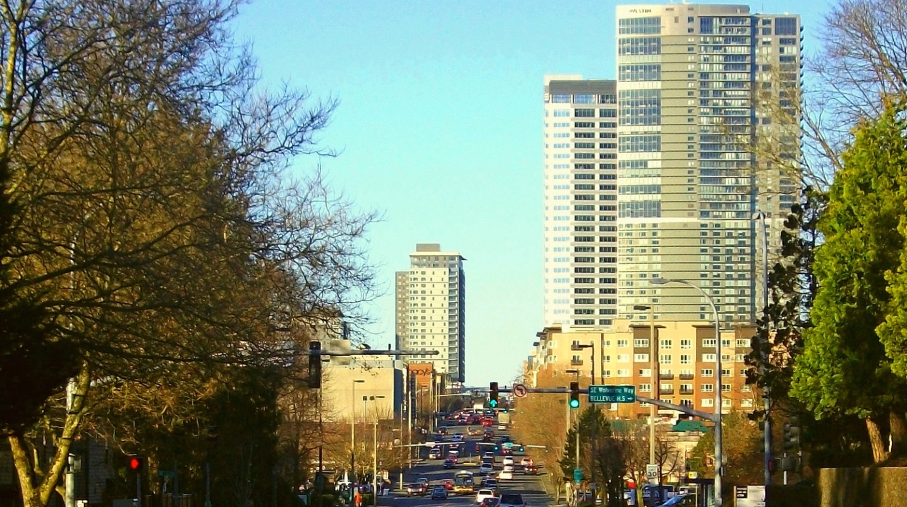
Job Growth
Job growth continues to outpace population growth in Bellevue.
The number of jobs in Bellevue grew at an average annual growth rate of 1.8% from 1995 to 2014.

Slide 5
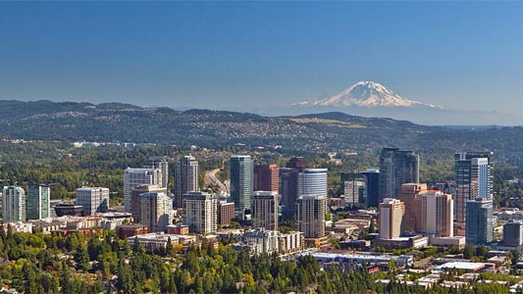
Job to Housing Ratio Trends
About 1.4 jobs are generated per household. It was 1980 when Bellevue last had a “balanced” jobs to housing ratio. Higher ratios indicate greater demand for housing, which lead to higher housing values.

Slide 6
Job Sector Distribution Trends
Job Sector Distributions: 2000 to 2014
The service sector is the largest job sector in Bellevue and has experienced fairly steady growth since 2004.
Retail, services, construction, and education all grew by over ten percent from 2010 to 2014. Government was the only job sector that experienced a decline.
Percent Job Change, 2010 to 2014
Service Sector Distribution, 2014

Slide 7
Where are people from?
Percent foreign born, 2015
Since 2000, Bellevue’s foreign born population has comprised about 93 percent of Bellevue’s population growth.
Source: U. S. Census Bureau, 1990 Census, 2000 Census, 2010 Census and 2015 American Community Survey
Notes:
In 2015, about 39 percent of Bellevue’s residents were born in a foreign country, about a third were born in Washington State, and just under 29 percent were born in a different U.S. state.

Slide 8
Where were Bellevue’s foreign born population born?
Over two-thirds of Bellevue’s foreign born population were born in Asia, followed by 16 percent from Europe, and 10 percent from Latin America.
India and China were the Asian countries from which most of Bellevue’s foreign born population were born.
Source: U. S. Census Bureau, 2010-2014 American Community Survey

Slide 9
How do native and foreign born populations differ socially & demographically?
% Who speak a language other than English
% of 15 years+ who are Married
% Minority
Age distribution
Average Household Size
Tenure
Structure type
Source: U. S. Census Bureau, 2010-2014 American Community Survey

Slide 10
How do native and foreign born populations differ economically?
Median household income
Percent in poverty
Educational attainment
Occupations
Source: U. S. Census Bureau, 2010-2014 American Community Survey

Slide 11
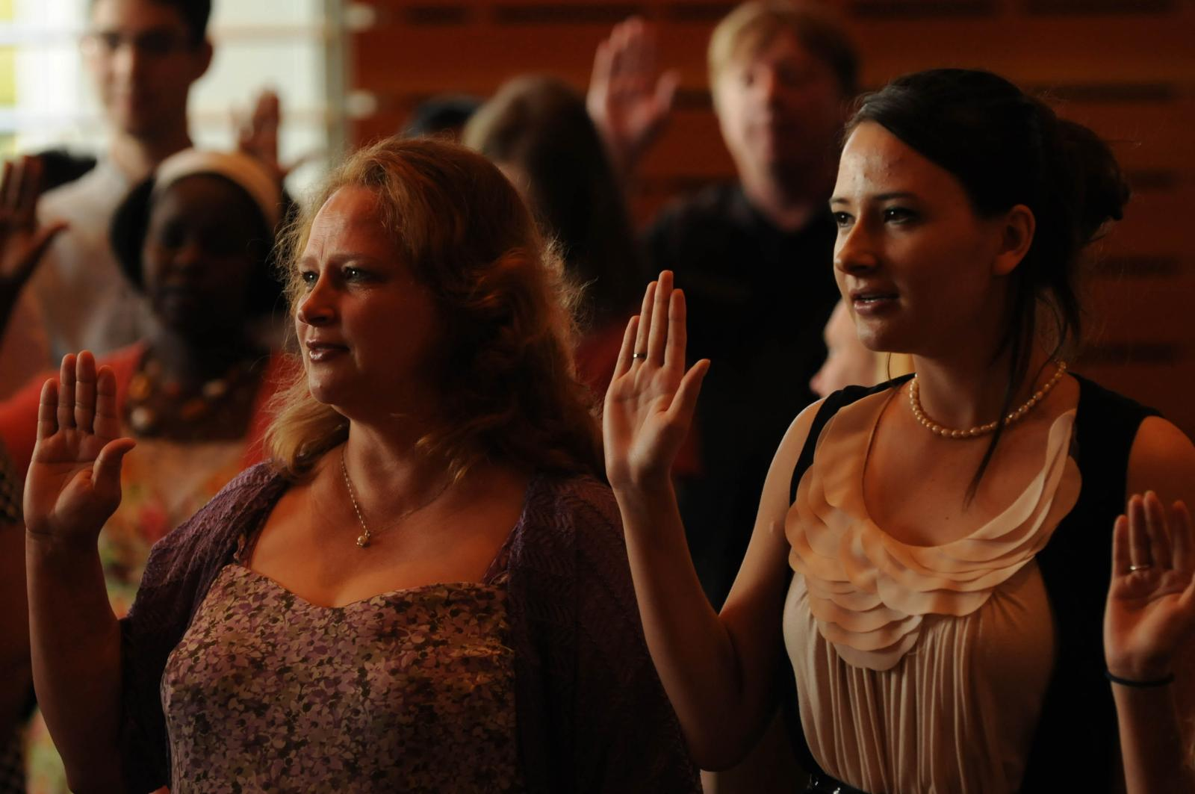
Cultural Diversity

Slide 12
Cultural Diversity: Past trends
Race Distribution Trends in Bellevue: 1970 to 2015
For the first time in 2015, non-Hispanic whites no longer represented the majority of people in Bellevue. Instead, a plurality of races/ethnicities existed.
Note: Race categories shown above include people of Hispanic or Latino origin. Hispanic or Latino populations are not shown separately in this chart as they are in the pie chart to the left.
Pct. Minority Trends in Bellevue: 1990 to 2015

Slide 13
Cultural Diversity: Asian population growth trends
Growth in Bellevue’s Largest Asian Populations 1990 to 2015
Growth in Bellevue’s Asian population has climbed dramatically in the past 25 years, climbing from about 8,500 in 1990 to 47,700 in 2015, an increase of 459 percent.
Bellevue’s Chinese and Asian Indian populations have grown the fastest, whereas Bellevue’s Korean and Japanese populations have stayed relatively the same.
Percent Asian Trends in Bellevue: 1990 to 2015
Source: U. S. Census Bureau, 1990 Census, 2000 Census, 2010 Census and 2015 American Community Survey

Slide 14
Cultural Diversity: Race & age comparisons
Race/ethnicity of Bellevue’s Population Under 18 years,
2010
Race/ethnicity of Bellevue’s
Population 65 years plus,
2010
In 2010, minorities were already the majority for Bellevue youth. In comparison, minorities comprised less than 17 percent of Bellevue’s older adult population, 65 years and over.
Source: U.S. Census Bureau, 2010 Census

Slide 15
Cultural Diversity: Place Comparisons
Race Distribution Comparisons, 2015
Compared to the United States, Washington state, King County and Seattle, Bellevue is more racially/ethnically diverse. However, Bellevue ranks 5th out of 11 of the state’s largest cities for having the highest percent minority. Our neighbors to the south all have higher percentages of minorities.
What is notable about Bellevue is its high percentage of Asian residents. Bellevue ranks 14th out of 319 large cities in the nation for having one of the highest percentages of Asian residents.
% Minority Comparisons in
2015 for Washington large cities
% Asian Comparisons in
2015 for U.S. large cities
Source: U. S. Census Bureau, 2015 American Community Survey

Slide 16
Cultural Diversity: Languages spoken
Top Languages Spoken at Home Other than English in Bellevue
Language | Bellevue Citywide |  | Speak English less than "very well"
 | Estimate | Percent of Pop 5 and Over | Estimate | Percent speaking specific lang.
Chinese | 11,356 | 9% | 5,349 | 47%
Spanish or Spanish Creole | 6,522 | 5% | 2,952 | 45%
Other Asian languages | 4,538 | 4% | 1,213 | 27%
Korean | 4,335 | 3% | 2,090 | 48%
Hindi | 3,373 | 3% | 690 | 20%
Russian | 2,738 | 2% | 1,211 | 44%
Japanese | 1,618 | 1% | 795 | 49%
Vietnamese | 1,482 | 1% | 821 | 55%
French (incl. Patois, Cajun) | 1,408 | 1% | 122 | 9%
Other Indic languages | 1,404 | 1% | 540 | 38%
Persian | 1,023 | 1% | 456 | 45%
Tagalog | 955 | 1% | 323 | 34%
Bellevue School District reported having 100 different languages spoken by children in enrolled during the 2015-2016 school year.
Percent of population 5 and over speaking a language other than English at home trends: 1990 to 2015
Source: U. S. Census Bureau, 2010-2014 American Community Survey

Slide 17
Cultural Diversity: Occupation comparisons
Occupation distributions by Race in United States, 2015
While every race and ethnicity has some people working in the different major occupation categories, the distributions of people working in each differ. For instance, 50 percent of Asians in Bellevue work in management, business, science and arts occupations whereas 15 percent of Hispanic or Latino residents work in those occupations.
How might growth in different job sectors affect Bellevue’s future race/ethnic distribution?
Source: U. S. Census Bureau, 2015 American Community Survey

Slide 18
Cultural Diversity: Median earnings comparisons
Median Earnings by Race/Ethnicity, 2010-2014
Median earnings for nearly all race/ethnicities are higher in Bellevue than they are in the U.S., Washington State, and King County, except for people of two or more races.
Yet, median earnings differ markedly between people of different race/ethnicities, with Asian’s having the highest median earnings and people of two or more races having the lowest.
Source: U. S. Census Bureau, 2010-2014 American Community Survey

Slide 19
Cultural Diversity: Factors affecting
Existing race/ethnic distribution
Job opportunities by sector
U.S. immigration policy
Educational opportunities
Housing opportunities
Quality of schools
Other factors?
What factors have influenced or will influence the distribution of races/ethnicities in Bellevue’s population?
Notes:
Existing age distribution
Job opportunities – number and types
Educational opportunities
Housing opportunities – how diverse is our housing in terms of age, size, attractiveness, affordability
Access to…
If we follow similar trends to the past where 129% of our growth since 2000 was of a minority race or ethnicity, over 60 percent of our population would be of a minority race or ethnicity by 2035.

Slide 20
Cultural Diversity: Future scenarios
What are some possible future scenarios, and what are their implications?
How might different scenarios impact City programs and provision of services?

Slide 21
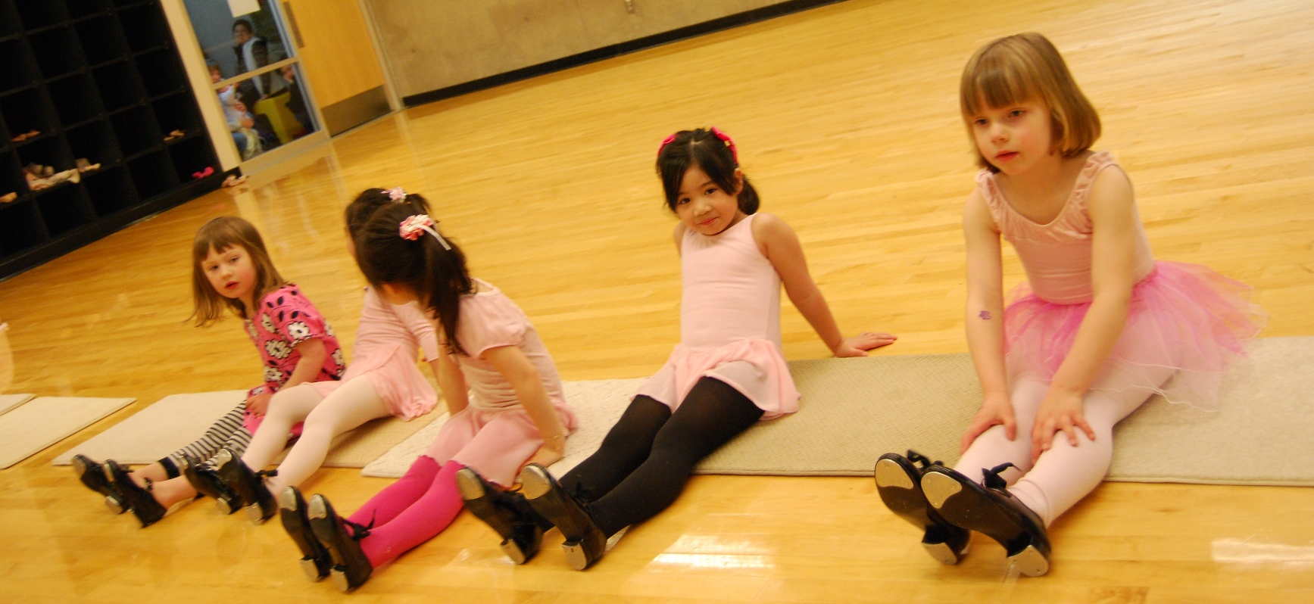
Age Diversity

Slide 22
Age Diversity: Past trends
Age Distribution Trends in Bellevue: 1970 to 2015
The population under 20 years of age witnessed dramatic declines from 1970 to 1990, but then held fairly constant from 1990 to 2010 until it dropped slightly in 2015.
In contrast, older adults 65 years and over witnessed dramatic increases from 1970 to 2000 and have since continued to increase, but more slowly.
Workforce age populations, 20 to 44 year olds and 45 to 64 year olds, witnessed increases early on, becoming the predominant age cohorts, but have experienced some fluctuations recently.
Median Age Trends in Bellevue: 1990 to 2015
Source: U. S. Census Bureau, 1990 Census, 2000 Census, 2010 Census and 2015 American Community Survey

Slide 23
Age Diversity: Place Comparisons
Age Distribution Comparisons, 2015
Bellevue currently has roughly the same age distribution as Washington state and the nation.
In the future as Bellevue urbanizes, will it maintain similarities with the state and nation or become more similar to Seattle, with smaller proportions of children and older adults?
Median Age Comparisons, 2015
Source: U. S. Census Bureau, 2015 American Community Survey

Slide 24
Age Diversity: National projections
In 2050, the population aged 65 and over is projected to be almost double of what it was in 2012, and by 2030, more than 20 percent of U.S. residents are projected to be aged 65 and over compared to 13 percent in 2010 and 9.8 percent in 1970.
Baby boomers are largely responsible for this increase as they began turning 65 in 2011. By 2030, all of the baby boomers will have moved into the ranks of the older population.
The Next America – Pew Research – Population Pyramid
Notes:
Future growth projections
Washington’s population is aging. This is a major demographic development that will have
important implications for policy-making and planning at all levels of government. In 2014
there are about 978,100 persons ages 65-and-older, representing 14 percent of Washington’s total
population. Growth in this age group will increase as the baby boom generation enters
retirement years, with an annual gain of about 41,600 in 2014 and peaking at 49,200 per year in
2018. By 2040, the elderly population is forecast to reach 1,867,400, representing 21 percent of
the state’s total population. The sharp spike in 65-and-older population growth in 2011
corresponds to a similarly sharp spike in births 65 years ago in 1946, exactly one year after
American servicemen returned home from World War II. These children of 1946 turned 65 in
2011, leading the baby boomer generation into retirement.

Slide 25
Age Diversity: Washington State forecast
Sources: Washington State Office of Financial Management, 2014 State Forecast
Notes:
By 2040, the elderly population in Washington State is forecast to reach 1,867,400, representing 21 percent of the state’s total population. The sharp spike in 65-and-older population growth in 2011 corresponds to a similarly sharp spike in births 65 years ago in 1946, exactly one year after American servicemen returned home from World War II. These children of 1946 turned 65 in 2011, leading the baby boomer generation into retirement.

Slide 26
Age Diversity: Puget Sound forecast
The average annual percent change per decade in Puget Sound’s older adult population is projected to rise from 1.9% in 2000 to 2010 to 4.4% in 2010 to 2020.
Source: Puget Sound Regional Council Draft 2014 Economic Forecast

Slide 27
Age Diversity: Factors affecting
Existing age distribution
Job opportunities
Quality schools
Housing opportunities
Others?
What factors may influence the distribution of ages in Bellevue’s population?
Notes:
Existing age distribution
Job opportunities – number and types
Educational opportunities
Housing opportunities – how diverse is our housing in terms of age, size, attractiveness, affordability
Access to…

Slide 28
Age Diversity: Future scenarios
What are some possible future scenarios, and what are their implications?
How might different scenarios impact City programs and provision of services?

Slide 29
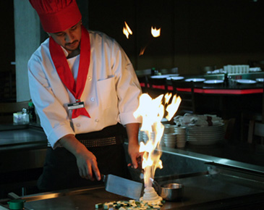
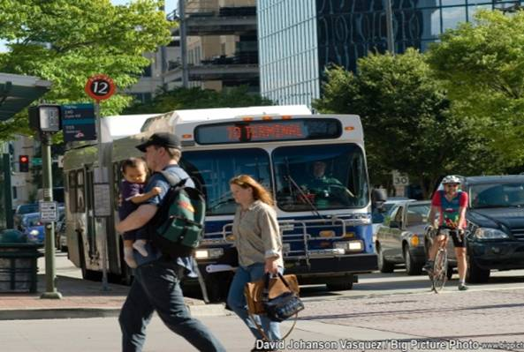
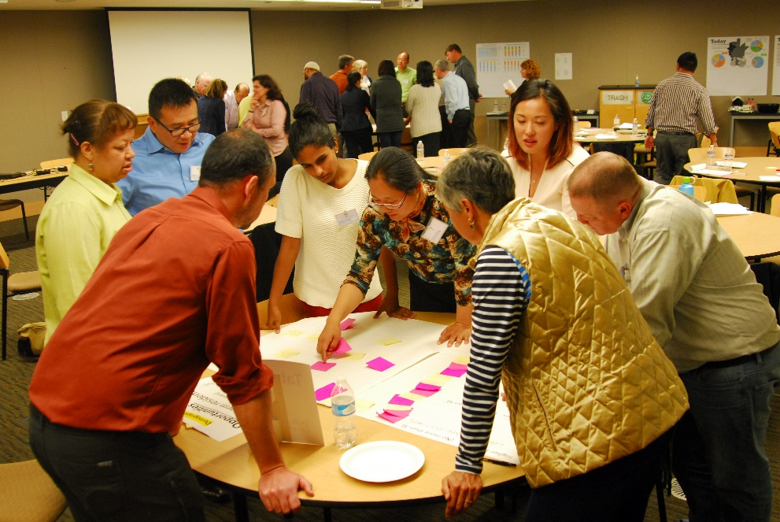
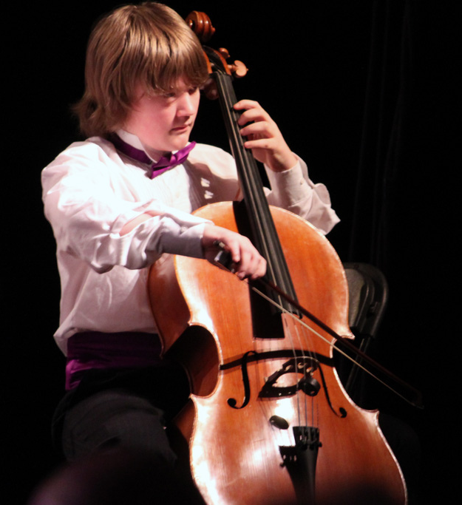
Economic Diversity

Slide 30
Economic Diversity: Past trends
Educational Attainment Trends in Bellevue: 1970 to 2015
As the percentage of Bellevue’s population 25 and older with bachelor’s degrees or higher has increased over the decades, so has Bellevue’s median household income.
Median Household Income Trends in Bellevue: 1990 to 2015 (in 2015 dollars)
Source: U. S. Census Bureau, 1990 Census, 2000 Census, 2010 Census and 2015 American Community Survey

Slide 31
Economic Diversity: Occupation Comparisons
Resident Occupation Distribution Comparisons, 2015
Bellevue is more like Seattle than the State or nation in having a higher percentage of residents who are employed in management, business, science and arts occupations.
These occupations also have the highest median earnings.
Bellevue Resident Earnings by Occupation, 2015
Source: U. S. Census Bureau, 2015 American Community Survey

Slide 32
Economic Diversity: Place Comparisons
Household Income Distribution Comparisons, 2015
About half of Bellevue’s households have incomes of $100K or above and half have income less than $100K.
Median Household Income Comparisons, 2015
Source: U. S. Census Bureau, 2015 American Community Survey

Slide 33
Economic Diversity: Factors affecting
Existing economic distribution
Job opportunities
Quality schools
Housing opportunities
Other?
What factors influence the distribution of economic classes in Bellevue’s population?
Notes:
Existing age distribution
Job opportunities – number and types
Educational opportunities
Housing opportunities – how diverse is our housing in terms of age, size, attractiveness, affordability
Access to…

Slide 34
Economic Diversity: Future Scenarios
What are some possible future scenarios, and what are their implications?
How might different scenarios impact City programs and provision of services?

Slide 35
How has Bellevue’s population changed over the decades?
Demographic Characteristic | 1990 Census | 2000 Census | 2010 Census/ ACS* | 2015 ACS
Median age | 35.4 | 38.2 | 38.5 | 37.4
Percent of population age 65 or older | 10% | 13% | 14% | 14%
Percent of a minority race or ethnicity | 15% | 28% | 41% | 50%
Percent Asian | 10% | 17% | 28% | 34%
Percent population foreign born* | 13% | 25% | 33% | 39%
Percent of population (age 5+) that speak a language other than English at home* | 14% | 27% | 38% | 42%
Percent of adults (age 25+) with a Bachelor’s degree or higher* | 46% | 54% | 59% | 66%
Percent of employed in management, business, science, and arts occupations* | 40% | 53% | 60% | 61%
Household median income (in 2015 inflation adjusted dollars)* | $76,759 | $84,200 | $87,499 | $98,804
Percent of individuals with incomes below poverty* | 6% | 6% | 7% | 7%
Percent of families with incomes below poverty* | 3% | 4% | 6% | 5%
Note: Not all American Community Survey estimates are directly comparable to decennial census figures.
Notes:
Bellevue was 14th in the nation out of 319 places for having one of the highest percentages of Asians, and it was the highest place in the nation outside of California and Hawaii.
Bellevue was 191st for it’s percentage of minorities.

Slide 36
For more information:
Gwen Rousseau, Associate Planner-Demographer
City of Bellevue Department of Planning and Community Development
(425) 452-2743
grousseau@bellevuewa.gov
U.S. Census Bureau
http://2010.census.gov/2010census/data/
http://factfinder2.census.gov/faces/nav/jsf/pages/index.xhtml

Slide 37
Diversity
“Bellevue welcomes the world. Our diversity is our strength. We embrace the future while respecting our past.”

Slide 38
Diversity
What opportunities, benefits and challenges do Bellevue’s demographic trends present?
Why do we value diversity?
How will increased diversity impact city programs and services?
How can we proactively prepare for future needs?
What skills/tools can we acquire to help us prepare effectively?
Notes:
What does this mean for the city? Is it a good thing? Why?
What opportunities, benefits and challenges does this trend present?
Cultural diversity broadens our possibilities for shared learning enabling Bellevue to become a hub of knowledge and innovation in all areas – technology, arts & culture, design etc. Learning about multiple perspectives enables one to build solutions with multiple benefits.
Stimulating the flow of ideas is key to reaping the full benefits of diversity. Overcoming barriers that block access to information and opportunity are some of the challenges the City must work to overcome so that as a City we are able to realize our collective potential.
Benefits of diversity also include greater adaptability and resilience. Challenges arise from a lack of connection between people from diverse backgrounds. The City can help by facilitating respectful processes that help people understand each other's diverse perspectives and form bonds with one another.
Challenges occur when one diversity trend affects another diversity trend i.e. race/cultural diversity may lead to less age and/or economic diversity. What actions could we take to encourage diversity at all levels?

