Slide 1
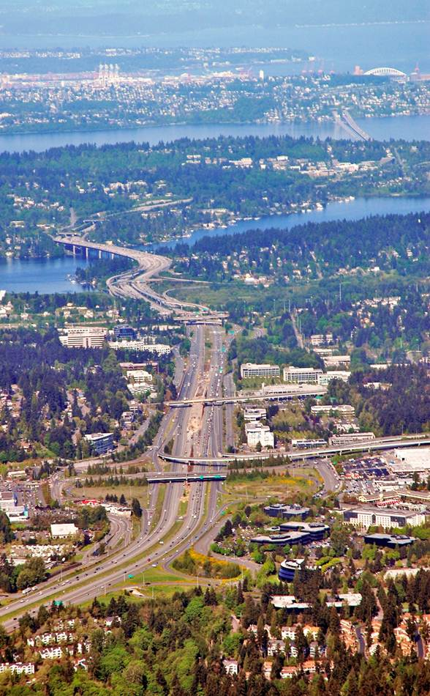
Eastgate/I-90 Land Use Code Amendments
Study Session
July 13, 2016

Slide 2
Eastgate luca Proposal
The PC is here to make a recommendation to the Council on the proposed land use code amendments.
There are three new districts proposed (EG-TOD, OLB 2, NMU). Each district has new
Dimensions
Development Regulations
Design Guidelines
Transition Area Design Guidelines
Conformance Amendments

Slide 3

Eastgate CAC 2010-2012
CAC provided recommendations with respect to
Comprehensive Plan/Subarea Plan
Transportation Facilities Plan
Land Use Code

Slide 4
The Process
The
Process
Comprehensive Plan Amendments including Eastgate Subarea Amendments Completed 2015

Slide 5
The Process
The
Process
Meanwhile, the Eastgate Transportation Projects were adopted into the Transportation Facilities Plan. Now awaiting funding.

Slide 6
The Process
The
Process
LUCA. We are here.

Slide 7
The Framework
The PC will review with respect to:
Consistent with the Comprehensive Plan including the Eastgate Subarea Plan? (The stage has already been set.)
Consistent with the CAC Final Report? (In the best interest of the citizens)
Consistent with the environmental review and other background documents?

Slide 8
Suggestions
“Wait to make changes until transportation projects are built”
Consistent with Comprehensive Plan? State law requires that the development regulations are consistent with Comprehensive Plan.
Consistent with CAC? The report allowed for phasing, but did not consider the issue above.
“While there will always be “choke-points” at particular intersections in the corridor regardless of what changes in land use might occur, we believe the consequences of growth can be addressed through a combination of intersection improvements, improved transportation mode choice, non-motorized transportation facilities (e.g., pedestrian paths and bike lanes), and partnerships with transit service providers (King County/Metro, WSDOT, Sound Transit).”
Timing

Slide 9
suggestions
“Do not require residential in new EG-TOD zone”
Consistent with Comprehensive Plan?
Policy S-EG-1. Focus Eastgate growth into a mixed use center adjacent to the Eastgate Transit Center with greater height and intensity than the surrounding area.
Policy S-EG-42. Encourage a mixed use area between Bellevue College and I-90 into a walkable, transit-oriented center at the level of intensity needed to create a vibrant mix of offices, residences, and locally-service shops and restaurants that are urban in character.
Consistent with CAC Final Report?
Land Use Code amendments should direct a substantial portion of the projected office and residential growth to the Transportation-Oriented Development Center….The Land Use Code regulations should ensure that development…includes:
b. An appropriate mixture of uses, including office, residential and retail.
EG-TOD

Slide 10
suggestions
“Increase parking garage height in EG-TOD from proposed 45 feet to 55 feet to accommodate retail on the ground floor”
Consistent with Comprehensive Plan? Yes
Consistent with CAC Final Report? Yes
Consistent with other studies and documents? Yes
“Increase building height in EG-TOD from 160 feet to 170 feet.”
EG-TOD

Slide 11
suggestions
“Allow driveways as allowable interruptions on main pedestrian street.”
Consistent with Comprehensive Plan?
POLICY S-EG-2. Establish a pedestrian-oriented street that provides a community
plaza and allows for connections between Bellevue College, the Eastgate Park
and Ride, and the office, retail, and residential development in the transit-oriented
development center.
Consistent with CAC Final Report?
CAC report repeated refers to a pedestrian-oriented main street.
EG-TOD

Slide 12
suggestions
“Increase proposed maximum FAR in NMU from 1.0 to 2.5.” (Currently, FAR is 0.5)
Consistent with Comprehensive Plan?
Specific FAR is not discussed in Eastgate Subarea Plan.
POLICY S-EG-1. Focus Eastgate growth into a mixed use center adjacent to the
Eastgate Transit Center with greater height and intensity than the surrounding area.
Consistent with CAC Final Report? “Maximum FAR: 0.75 to 1.0 is recommended”
Consistent with Environmental Analysis? Environmental analysis studied up to 1.0 FAR. Change would require additional analysis and delay.
Also consider impact to adjacent residential zones.
NMU

Slide 13
suggestions
“Use an incentive system in NMU Base FAR 1.25, Max 2.5” (Currently, FAR is 0.5)
Consistent with Comprehensive Plan?
POLICY S-EG-44. Consider the use of a land use incentive system in office and
mixed use areas that incentivizes provision of infrastructure and amenities that offer
public benefits through the potential for additional floor area ratio (FAR) and height.
POLICY S-EG-1. Focus Eastgate growth into a mixed use center adjacent to the
Eastgate Transit Center with greater height and intensity than the surrounding area.
Consistent with CAC Final Report? “Maximum FAR: 0.75 to 1.0 is recommended”
Consistent with Environmental Analysis and other reports?
Environmental analysis only studied up to 1.0 FAR
Also, economic analysis determined that an incentive system was not viable in the area. Economics would dictate that developers would build to Base FAR and provide no public amenities.
NMU

Slide 14
suggestions
CAC - New development on properties that receive additional development capacity as a result of the Eastgate/I-90 Land Use & Transportation Project (e.g., from the existing maximum FAR of 0.5 to something greater) should provide or contribute to public benefits as a condition of realizing
that added capacity.
NMU

Slide 15
suggestions
“Change the lot coverage in NMU from proposed 35% to 70% like Bel-Red”
Consistent with Comprehensive Plan?
POLICY S-EG-6. Ensure that increases in impervious surface area or stormwater
runoff will not increase the quantity or worsen the stormwater quality entering public
drainage systems, streams, Phantom Lake, Lake Washington, and Lake Sammamish.
(The NMU in the Eastgate area would drain to Vasa Creek. Increasing the lot coverage from proposed 35 to 70% would increase the quantity of stormwater entering the public drainage system. Given that there are no natural drainage requirements in proposed NMU as there are in Bel-Red.)
Also many general policies to reduce impervious surface.
Consistent with CAC? No specific passages about lot coverage, but does favor reduction of impervious surface and low impact development.
NMU

Slide 16

Questions
Questions from the
Commission?

Slide 17
Next steps
NEXT STEPS
Planning Commission transmits recommendation to Council
Council considers Eastgate Land Use Code Amendments
For More Information:
http://www.bellevuewa.gov/eastgate-corridor.htm
Terry Cullen, Comprehensive Planning Manager, Planning and Community Development, 452-4070, tcullen@bellevuewa.gov
Trish Byers, Code Development Manager, Development Services, 452-4241, pbyers@bellevuewa.gov

Slide 18
New land use Districts

Slide 19
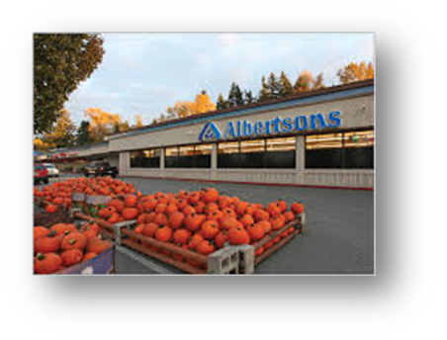
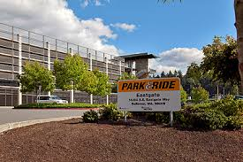
LAND USE Code amendments
LAND USE CODE AMENDMENTS
THREE NEW DISTRICTS PROPOSED
  Eastgate Transit Oriented Development (EG-TOD)
  Office Limited Business (OLB 2)
  Neighborhood Mixed Use (NMU)
Within Each Zone
  Uses
  Dimensional Requirements
  Development Standards
  Design Guidelines

Slide 20
EG-TOD Transit Oriented Development District (EG-TOD). The purpose of the TOD District is to provide an area for a mix of housing, retail, office, and service uses, with an emphasis on housing. The district is limited in area so that there is an appropriate level of density nearest the highest levels of transit service.
FAR - 2.0 +
  Up to 1.0 excepted for Affordable Housing, Open Space, Public Restrooms, Special Dedications and Transfers
Max. Bldg. Ht. 160 ft. (10-12 stories) /45 ft.

Slide 21
EG-TOD dimensions
Neighborhood Mixed Use (NMU). The purpose of the NMU District is to provide an area with a mix of retail, service, office and residential uses with an emphasis on neighborhood retail and service uses. This district is designed to be compatible with nearby neighborhoods and is easily accessible from the nearby office and residential uses.
FAR – 1.0 + Up to 1.0 FAR excepted for Affordable Housing
Max. Bldg. Ht. – 75 ft. (about 5-6 stories)

Slide 22
EG-TOD dimensions
Office Limited Business District 2 (OLB 2). The purpose of the OLB 2 District is to provide an area of integrated complexes made up of offices, hotels, or motels, eating and drinking establishments, and retail sales within walking distance to support business and employees. The OLB 2 District has greater intensity and a larger mix of uses than the OLB District. Such districts are located in areas that abut and have convenient access to freeways, major highways, and transit.
FAR – 1.0
Max. Bldg. Ht. – 75 ft. (about 5-6 stories)

Slide 23
Transition area design district
Transition Area Design District
  Applies to OLB 2 and NMU where they
  are adjacent to a residential district
  NMU, OLB 2 45/75 ft.
  Landscape Buffer – Usually 20 ft.
  Usually may not exceed max. height of receiving district
  Mechanical equipment in mech. room
Conformance Amendments
  Ensures that the new amendments
  conform with the code.
Max. Height for
OLB 2 or NMU
OLB 2 or NMU
Residential District

