Slide 1
EAST MAIN
STATION AREA PLAN
CITIZEN ADVISORY COMMITTEE
January 26, 2016

Slide 2
PROJECT UPDATE & NEXT STEPS
Tonight’s meeting objectives
  Complete discussion & direction
    CAC draft vision statements
    CAC draft strategies
  Confirm open house objectives & remaining schedule
    February 23rd – draft report & open house materials
    February 22nd – March 11th (tentative) – online open house – public comment on CAC draft vision & strategies
    March 3rd (tentative) – in-person open house
    March 29th (tentative) – finalize report & recommendations

Slide 3
Discussion & approval of Draft Vision Statements and Strategies
Issue/Topics
Hide-and-ride parking in the neighborhood
Pedestrian/bicycle improvements in the station area
Future look and feel for Main Street
Future look and feel for 112th Avenue SE
Redevelopment fronting along east side of 112th Avenue SE
Pedestrian/bicycle connectivity to the station from the wider area
Neighborhood access (motorized and non-motorized)
Future land uses for redevelopment area
Future look and feel of redevelopment area
Tonight

Slide 4
CONTEXT
Traffic Changes -
Street closures along 112th Avenue SE
  50 vehicles entering residential neighborhood diverted to remaining entry points (PM Peak Hour)
Overall growth
  Traffic will grow over next 20 years with increased population and employment
  City will continue to monitor and mitigate traffic growth
Redevelopment east of 112th Avenue SE
  Redevelopment land uses are not additive to overall growth but are reallocated from other parts of the city, especially downtown
  Will increase traffic, especially along 112th Avenue and 114th Avenue SE, but only as a small proportion of overall growth
  Little or no impact to residential neighborhood access from Main Street, 108th Avenue SE

Slide 5
G. NEIGHBORHOOD ACCESS
(motorized and non-motorized)
CAC Draft Vision:
  Neighborhood access points have been modified to facilitate vehicular access for residents, improve safety for pedestrians and bicyclists, and effectively prohibit non-residents from cutting through on neighborhood streets.
  The city continues to monitor and manage traffic on arterials and collector arterials.
  Sidewalks have been installed at all neighborhood access routes to improve pedestrian safety.

Slide 6
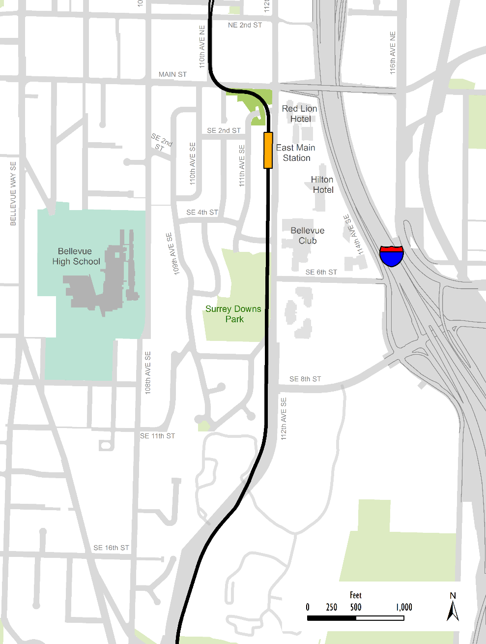
8 CAC Draft Strategies (a-h)
Update traffic calming guidelines
Continue to monitor and enforce access restrictions at Main Street and 108th Avenue
Coordinate additional traffic calming measures for 108th Avenue SE with measures for 109th Avenue SE
Maintain the existing access restrictions at Main Street and 110th Avenue SE
Add a protected left turn signal phase for westbound Main Street to southbound 108th Avenue SE
Evaluate the potential for marked crosswalks or other treatments to highlight pedestrian crossings
Install sidewalk on one side of SE 16th Street from Bellevue Way to 108th Avenue SE
Incorporate recommendations of the station area plan into subsequent studies and programs to achieve the vision for Main Street
h
b
e
d
h
f
c
405
c
f
g

Slide 7
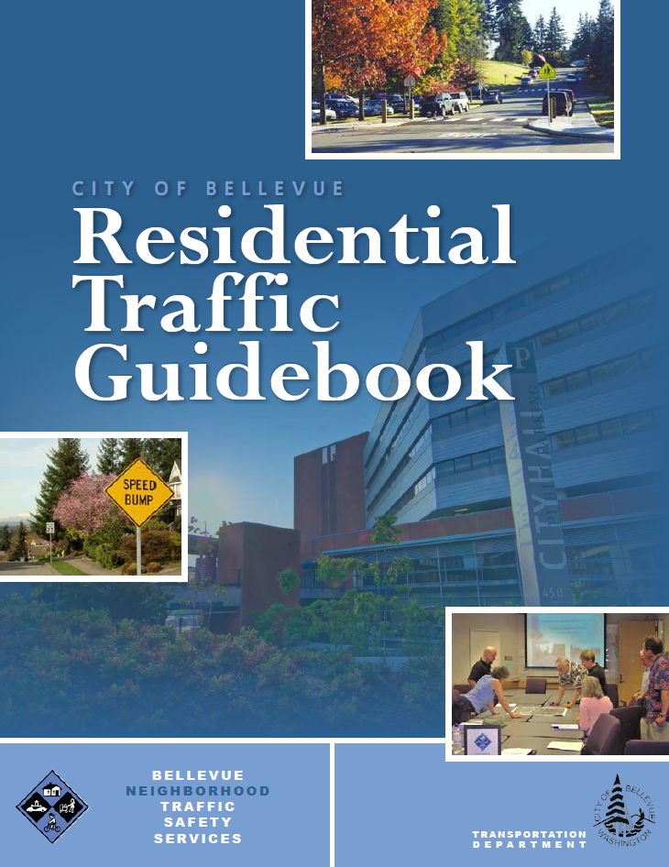
Strategy a) - Update the city’s traffic calming guidelines to lower the speed threshold for the implementation of traffic calming measures around light rail stations
Importance of traffic calming for safety in light rail station areas, given potential for increased number of people walking

Slide 8
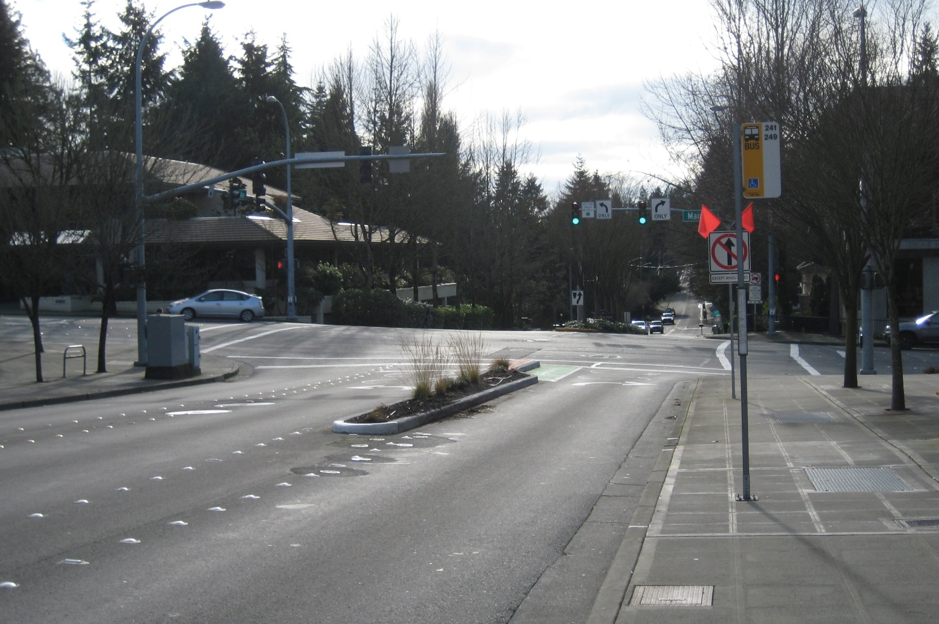
Strategy b) - Continue to monitor and enforce access restrictions from downtown to 108th Avenue SE
10% of vehicles observed making illegal southbound through movement from right turn lane
115 citations for southbound violations March – December 2015
108th Avenue at Main St

Slide 9
Strategy c) - Coordinate additional traffic calming measures for 108th Avenue SE with measures for 109th Avenue SE to discourage cut-through traffic and maintain safety on local streets
Traffic Calming Approach | Balancing factors
Speed humps | Concerns from bus riders and emergency vehicles
Median islands/”chokers” | Not typically used on local streets since they restrict access
Chicanes | Not typically used on local streets since they can restrict access
Speed signs | Not typically used on local streets given low volumes
Raised intersections/crosswalks | Concerns from bus riders and emergency vehicles
Roundabouts | Requires a lot of right-of-way
Traffic circles | Needs study on arterial streets to ensure bus access and adequate sight lines
Narrow lanes | Typically only relevant for multi-lane streets
On-street parking | May require additional right of way
Intersection turn restrictions | Difficult to enforce
Traffic signal timing | Long delays on “minor” street can lead to large queues and complaints from drivers
One lane section | Only works for low-volume streets
Half-street closure | Restricts access for all drivers
Diagonal diverter | Restricts access for all drivers

Slide 10
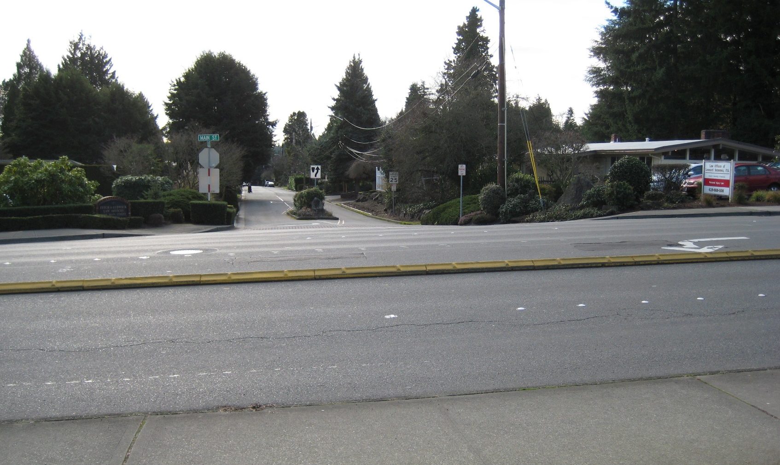
Strategy d) - Maintain the existing access restrictions at Main Street and 110th Avenue SE

Slide 11
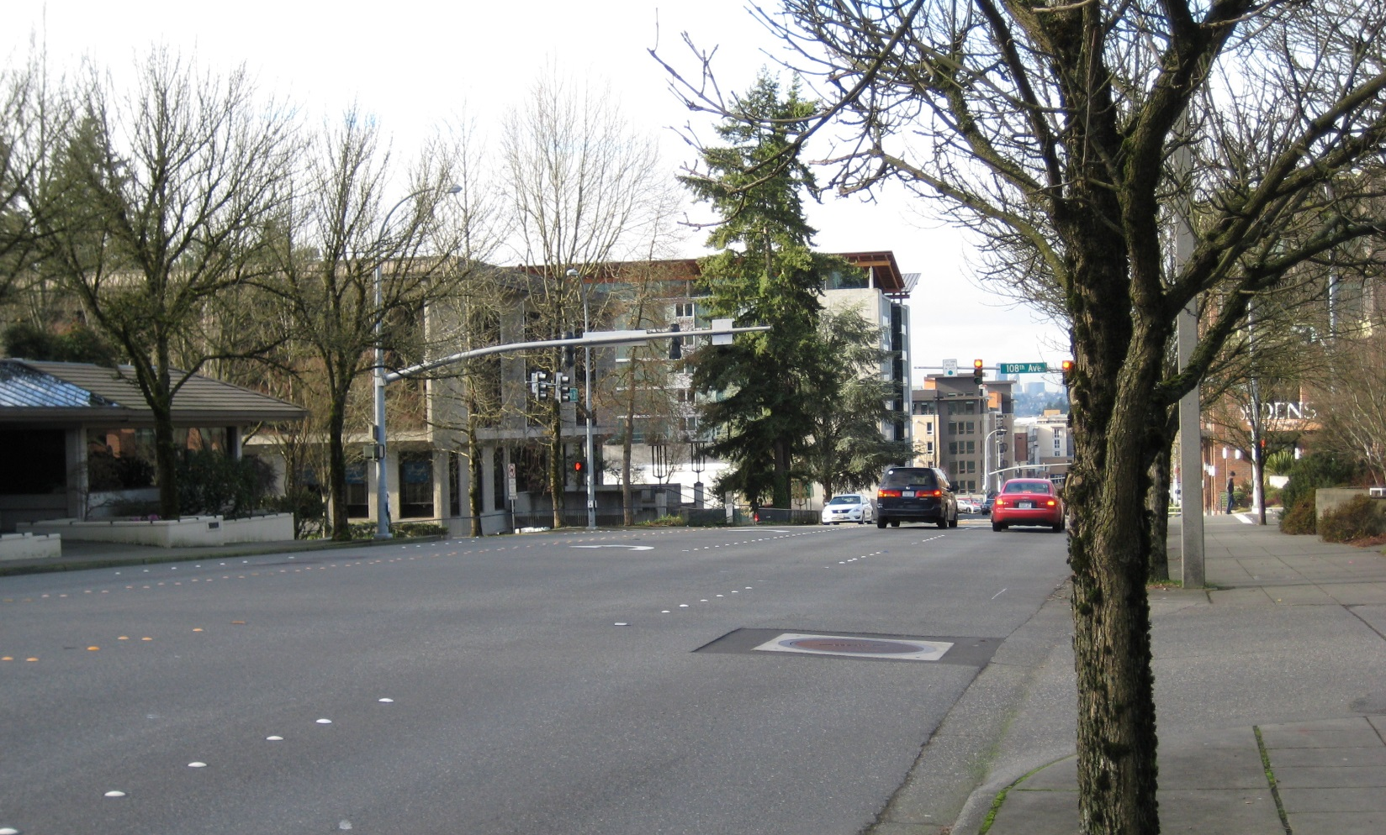
Strategy e) - Add a protected left turn signal phase for westbound Main Street to southbound 108th Avenue SE to facilitate residential neighborhood access
Main St at 108th Avenue

Slide 12
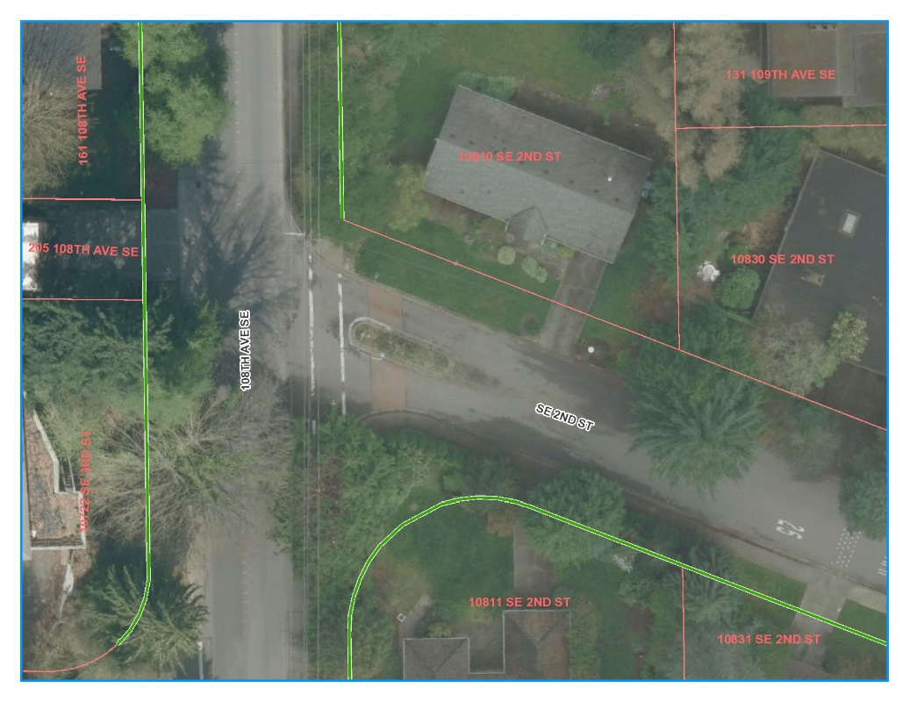
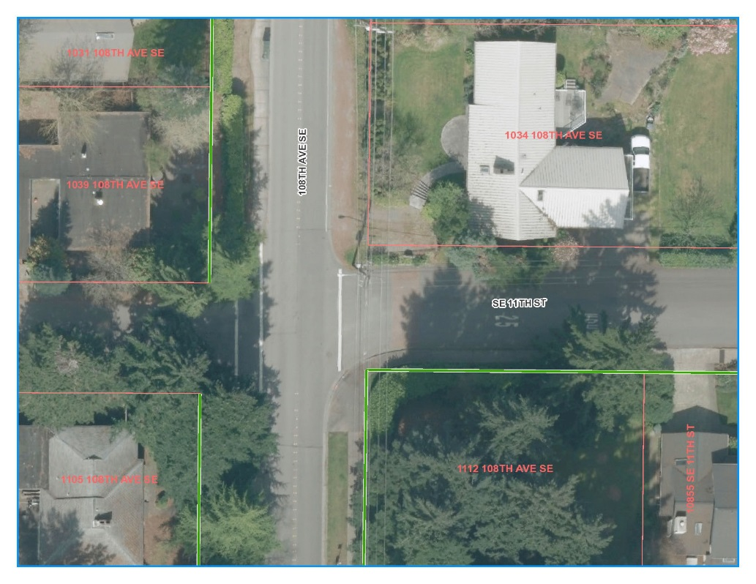
Strategy f) - Evaluate the potential for marked crosswalks or other treatments to better highlight pedestrian crossings at SE 2nd St and SE 11th St from existing sidewalk that leads out of the these streets to the existing sidewalk on the west side of 108th Ave SE
SE 2nd Street at 108th Avenue SE
SE 11th Street at 108th Avenue SE

Slide 13
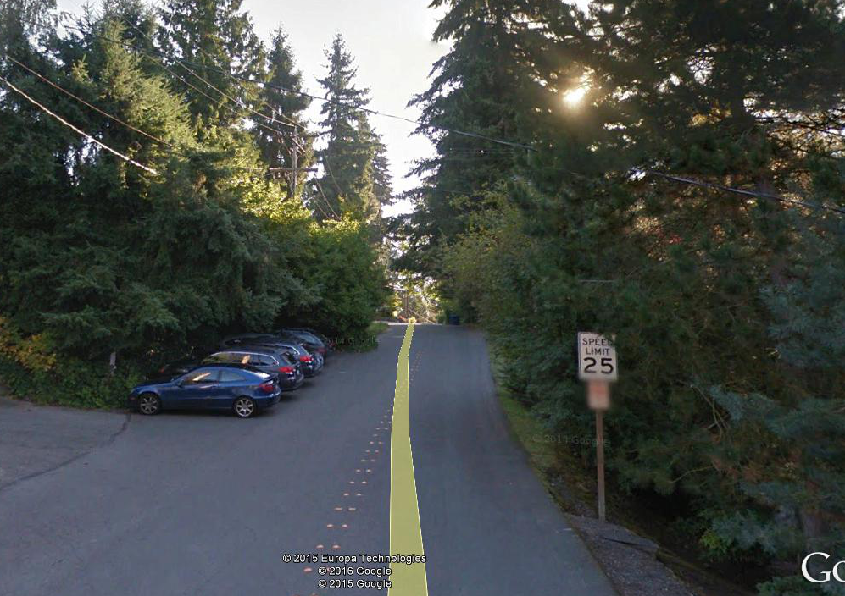
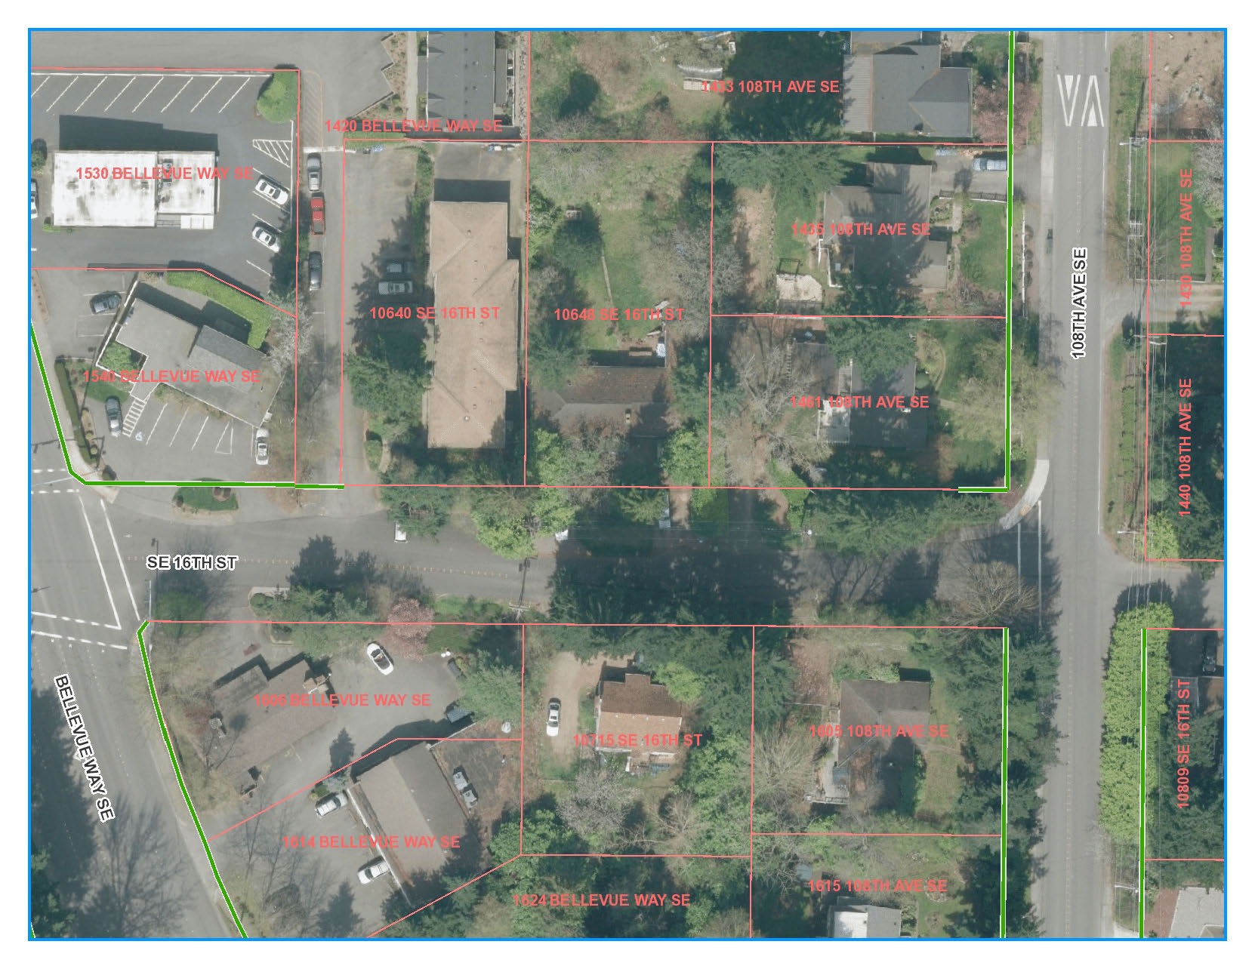
Strategy g) - Install sidewalk on at least one side of SE 16th St from Bellevue Way to 108th Ave SE

Slide 14
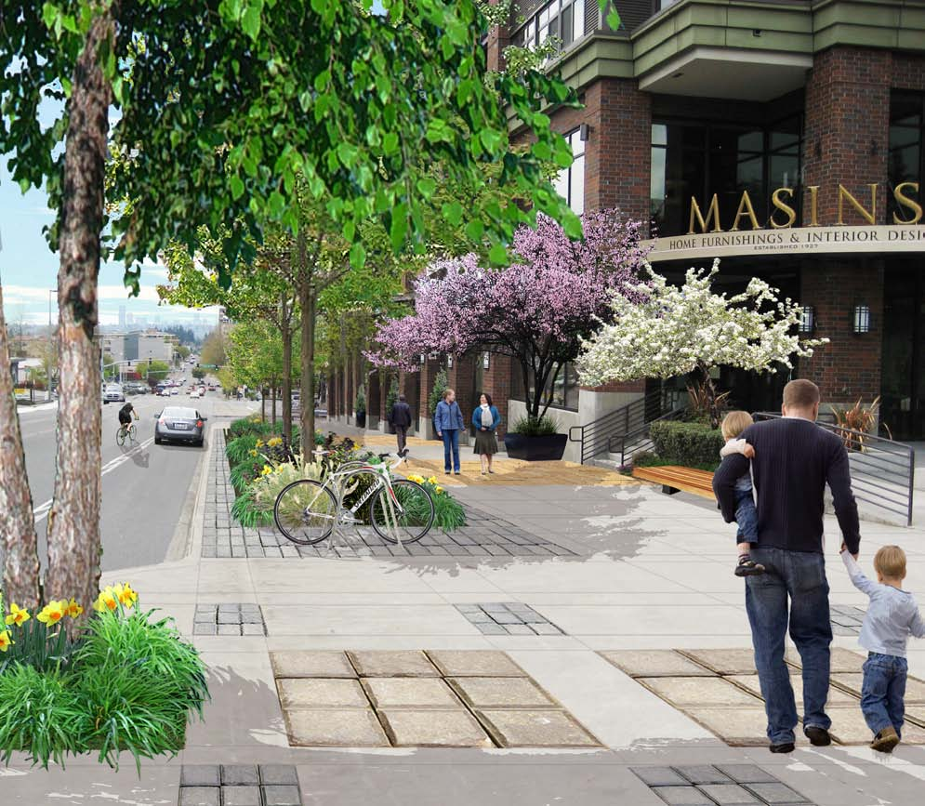
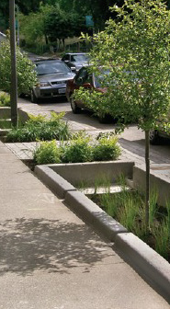
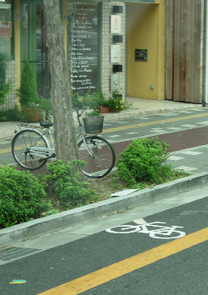
Strategy h) - Incorporate the recommendations of the East Main Station Area Plan into subsequent studies and programs (e.g. multi modal level-of-service, corridor studies) to achieve the vision for Main Street
Illustration of potential treatments for Main Street

Slide 15
Downtown Mixed Use
Residential
Primary TOD
Secondary TOD
Office/Light Industrial

Slide 16
H. FUTURE LAND USES FOR REDEVELOPMENT AREA
Mix of uses
  Retail & services
  Office & hotel uses
  Variety of multi-family types, unit sizes & affordability
Scale
  Height
  Placement
  FAR
Quality (Topic I: Look & Feel)

Slide 18
OLB between Main & SE 6th
Citywide context (currently)
Downtown – highest buildings & FAR in city
  Non-residential FAR: 0.5 – 8.0
  Residential FAR: 3.0 – unlimited
  Non-residential height: 45’ – 450’
  Residential height: 55’ – 450’
BelRed – maximum 4.0 FAR & 150’ height with bonus/incentives
OLB – maximum 0.5 FAR & 90’ height

Slide 20
OLB between Main & SE 6th
Local context (currently)
SE Downtown – transition (edge of wedding cake)
  Non-residential FAR: 1.0 – 3.0
  Residential FAR: 3.0 – 3.5
  Non-residential height: 45’ – 75’
  Residential height: 55’ – 90’
OLB (south of Main St.)
  FAR 0.5
  Height 30’ – 75’

Slide 21
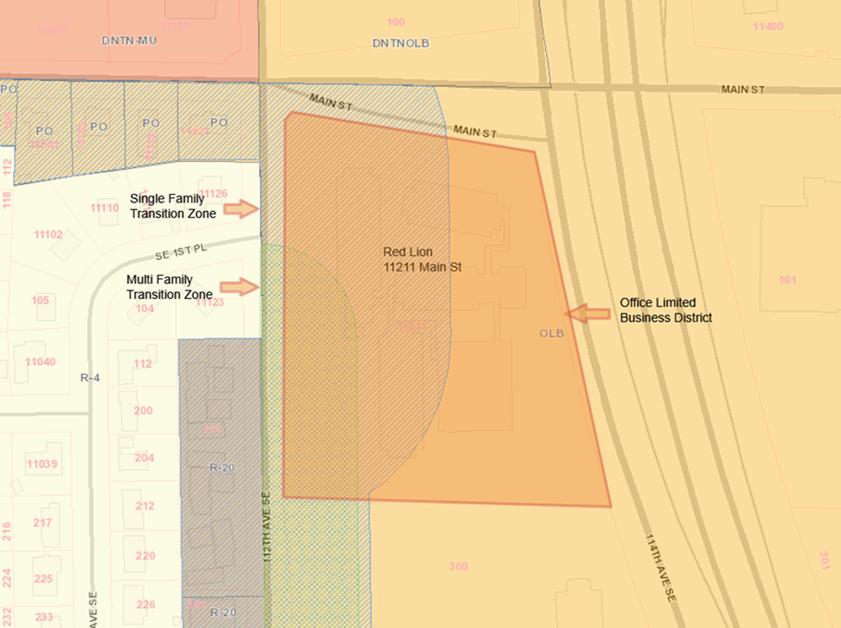

Slide 22

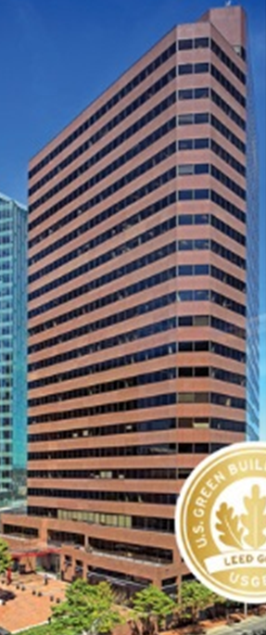
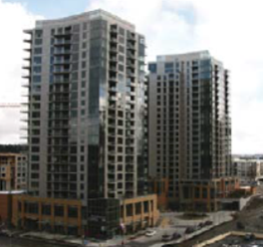
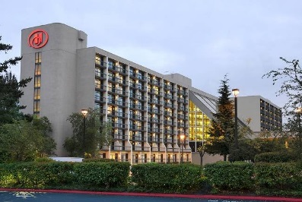
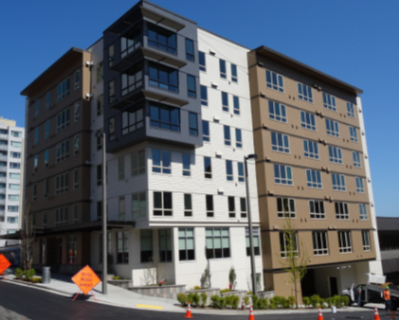
Building Height Examples
292’
Skyline Tower
300’
235’
WA SQ
200’
110’
Hilton Hotel
100’
70’
LIHI
75’

Slide 23
Mount Rainier View Corridor

Slide 24
OLB between Main & SE 6th
Recommended
Maximum FAR: 4.0 Maximum Height: 200’
  8x FAR currently allowed in OLB
  More than currently allowed immediately north of Main
  FAR comparable to BelRed TOD zones w/greater height (150’ BelRed)
  Achievable only with bonus/incentive system – inclusion of design characteristics (e.g. public space & green space, structured parking, noise attenuation, affordable housing)

Slide 25
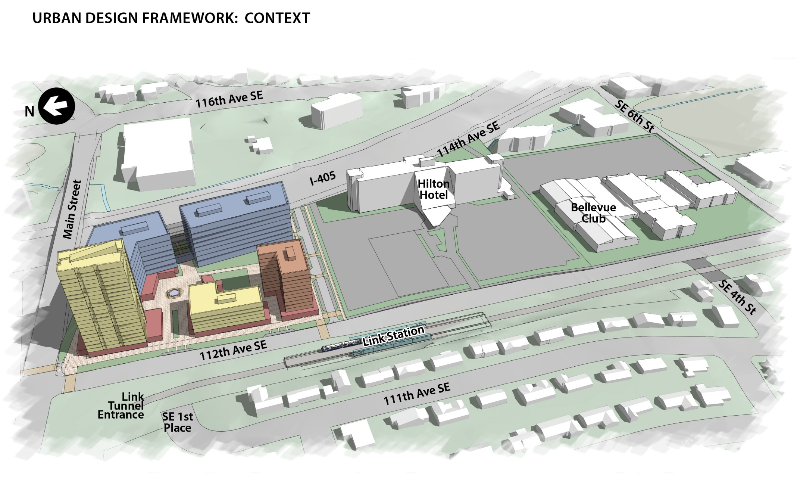

Slide 26
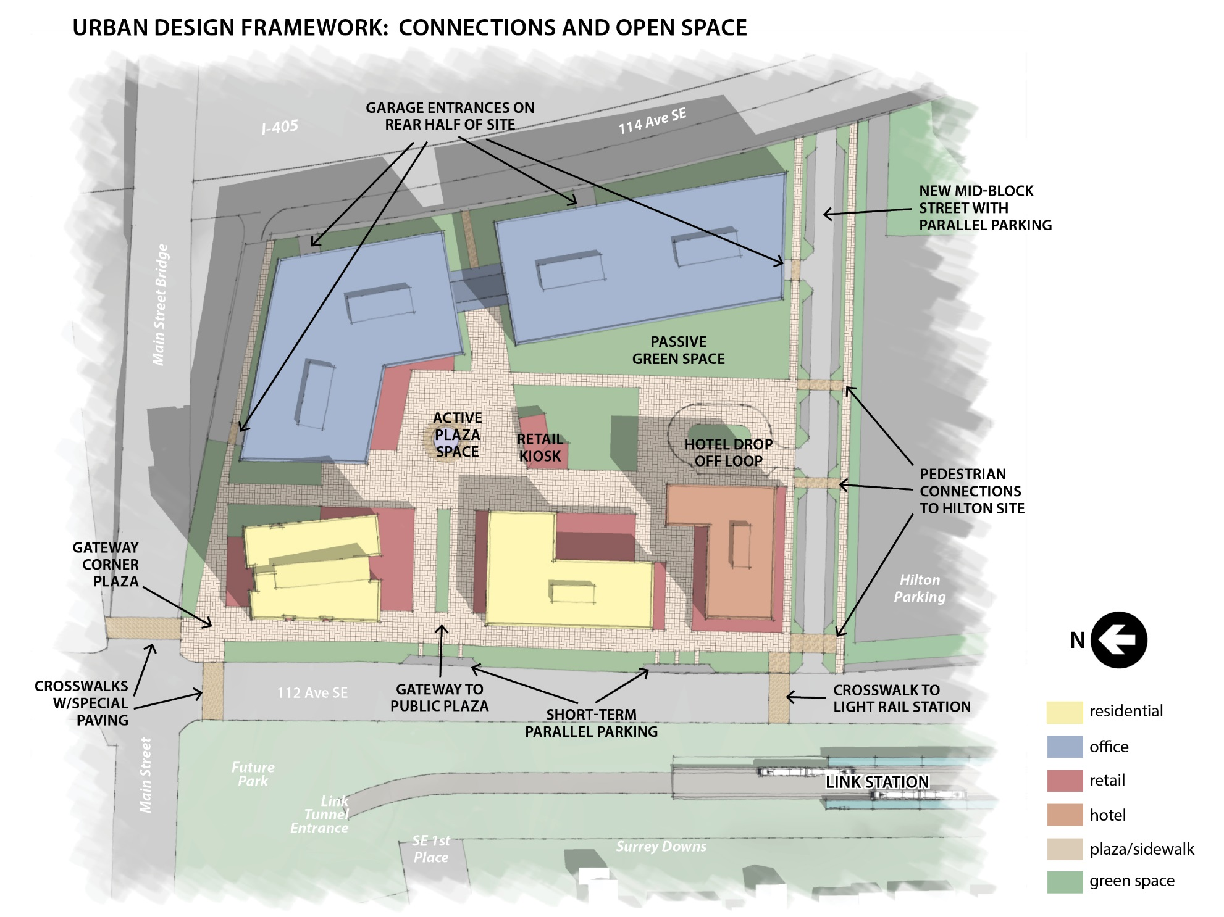

Slide 27
