Slide 1

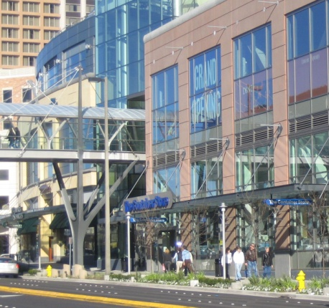
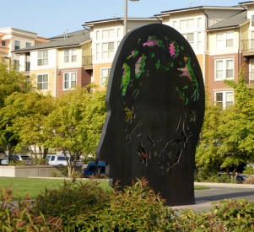
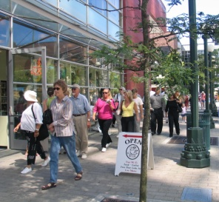
Downtown Livability Initiative
Planning Commission Study Session October 26, 2016

Slide 2
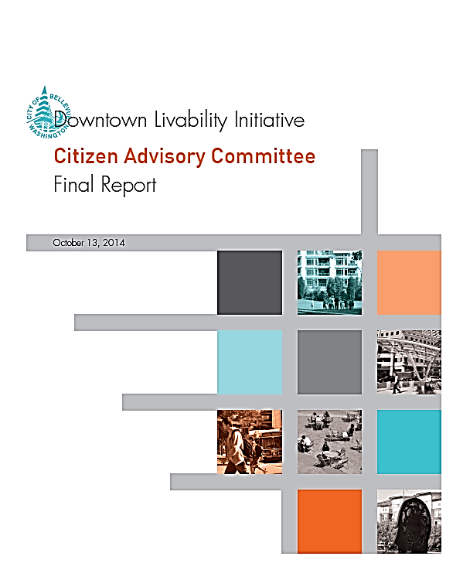
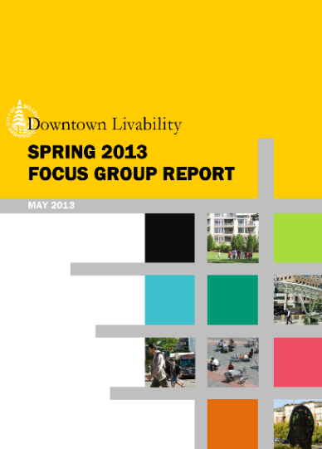
Overall – Where We Are Now
PUBLIC ENGAGEMENT
Work of Council-Appointed Citizen Advisory Committee (CAC)
Council
Receives CAC Recs.
Planning Commission Review and Refinement
Council Consideration for Adoption
Early Wins Ord. 6277 3/7/16
We Are Here
Major Council Direction to Date:
Overall Scope and Project Principles
Charge to Planning Commission re: Review of CAC Recs. (5/2015)
Council Direction on Incentive Zoning (1/2016)
2

Slide 3
Application of the Green and Sustainability Factor
Tonight – Staff to run through sample development project using the Green and Sustainability Factor. No Commission action is required at this time. Worksheet to be posted for testing and feedback.
3

Slide 4
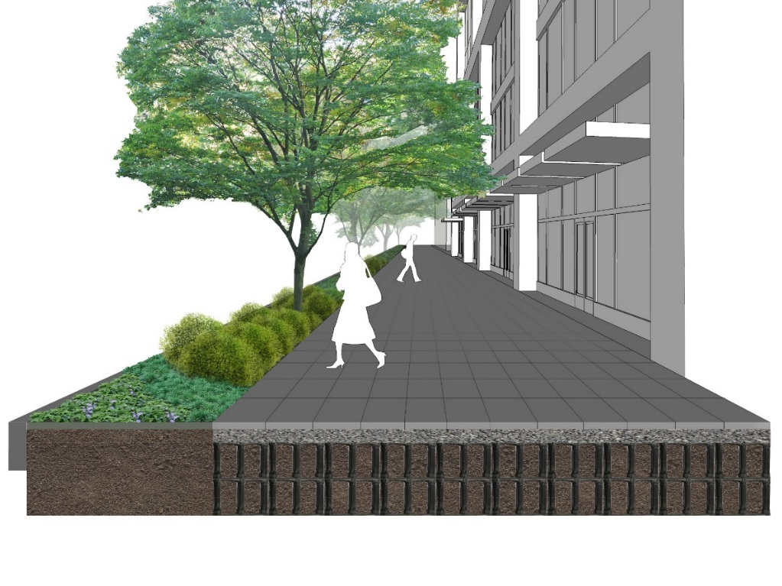
The Green and Sustainability Factor
Intent:
Offer a menu of elements that all contribute towards livability of Downtown
Help soften and mitigate impacts of dense urban development
Improve sustainability: Reduce stormwater runoff, promote walking and biking, native and drought tolerant plants, pea patches, and encourage green building technologies
Combination of publicly accessible and private features

Slide 5
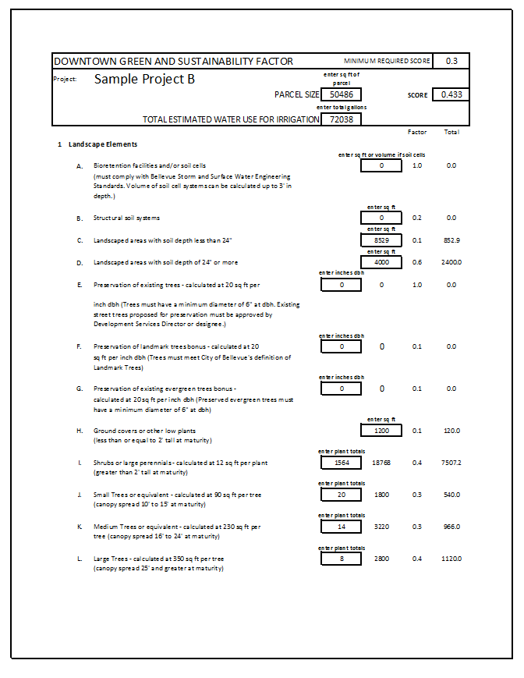
The Green and Sustainability Factor
Process:
New developments will be able to use Green Factor worksheet to test different approaches for their project
Input cells for square footage of planting area, plant totals, annual irrigation budget, type of plants, etc.
Menu allows for flexibility by project
Multipliers are weighted for each factor
Sample:
50,486 sf parcel x 0.3 = 15,146 req.
Provided 0.433 or 21,862

Slide 6
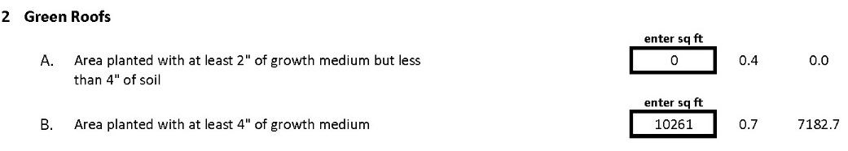
Ability to Stack Green Elements
Example Element: Green Roofs
If a green roof is planted with at least 4” of soil/growing medium the green roof area can be counted as multiple elements:
Landscaped areas (sq ft), multiplier 0.1
Ground cover areas (sq ft), multiplier 0.1
# of shrubs (12 sq ft per plant), multiplier 0.4
# of small trees (90 sq ft per tree), multiplier 0.3
# of medium trees (230 sq ft per tree), multiplier 0.3
Green roof area (shown below), multiplier 0.7
Outcome: Depending on the design of the green roof, it could receive more credit towards the Factor then simply the square footage of the green roof

Slide 7
Current 20-foot Linear Buffer on Edges of Downtown
Tonight – Discuss provisions for required sidewalks and 20-foot linear landscape buffer in Perimeter Overlay A-3 with the Commission. Seek Commission direction on additional analysis.
7

Slide 8
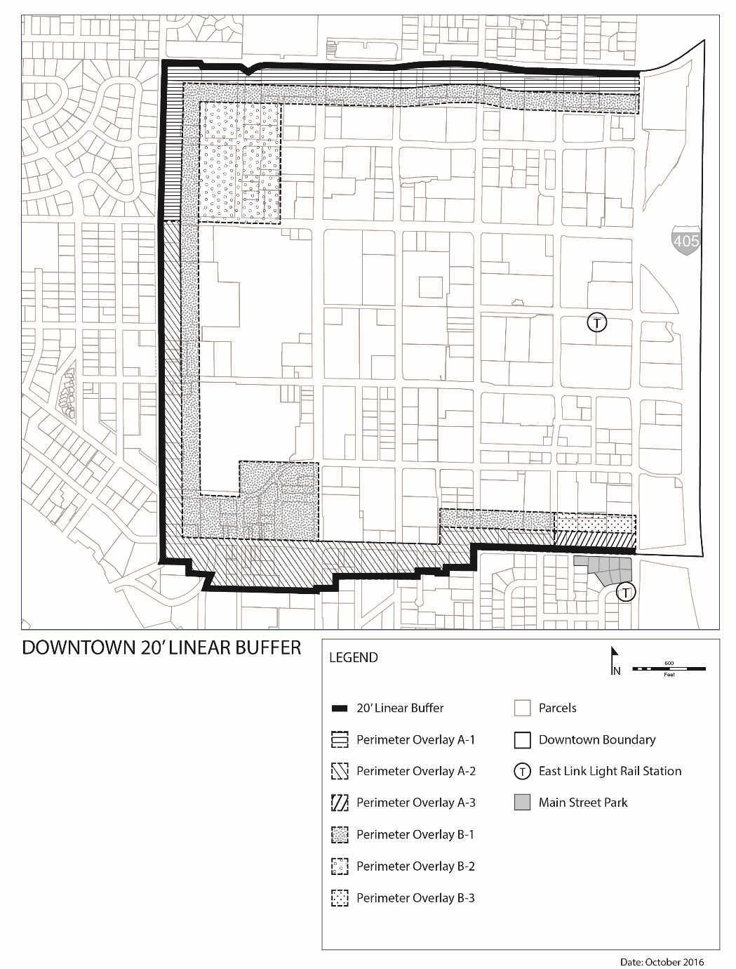
20-Foot Linear Buffer
20-foot Linear Landscape Buffers between outer Boundary Downtown and Perimeter Overlay A
  Adjacent to Right-of-Way or Public Places – Paved up to 25% may be paved and used for private residential recreation.
  Adjacent to Private Property – Up to 25% of setback area may paved and used for patios and residential entries.
Perimeter Overlay A-3
Location of Buffer

Slide 9
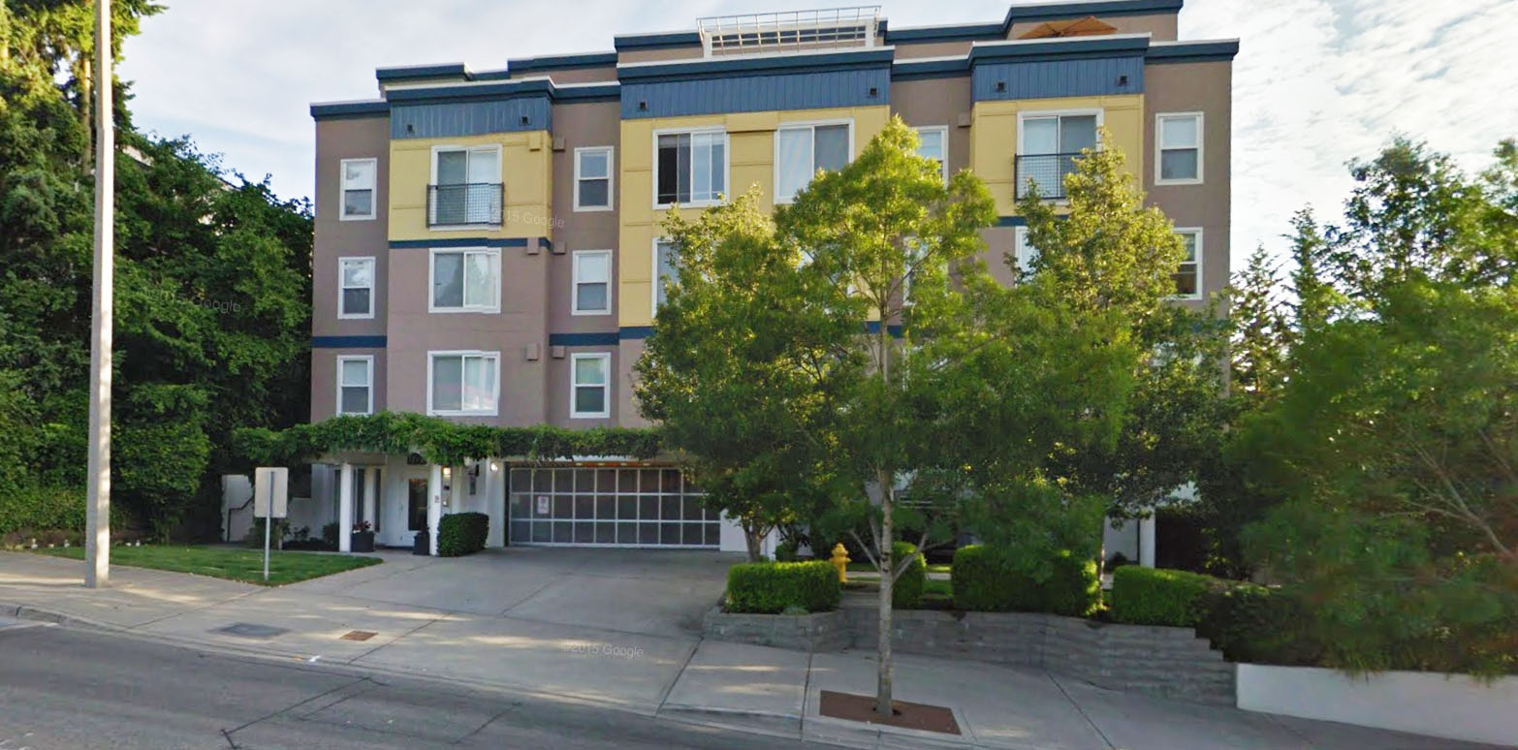
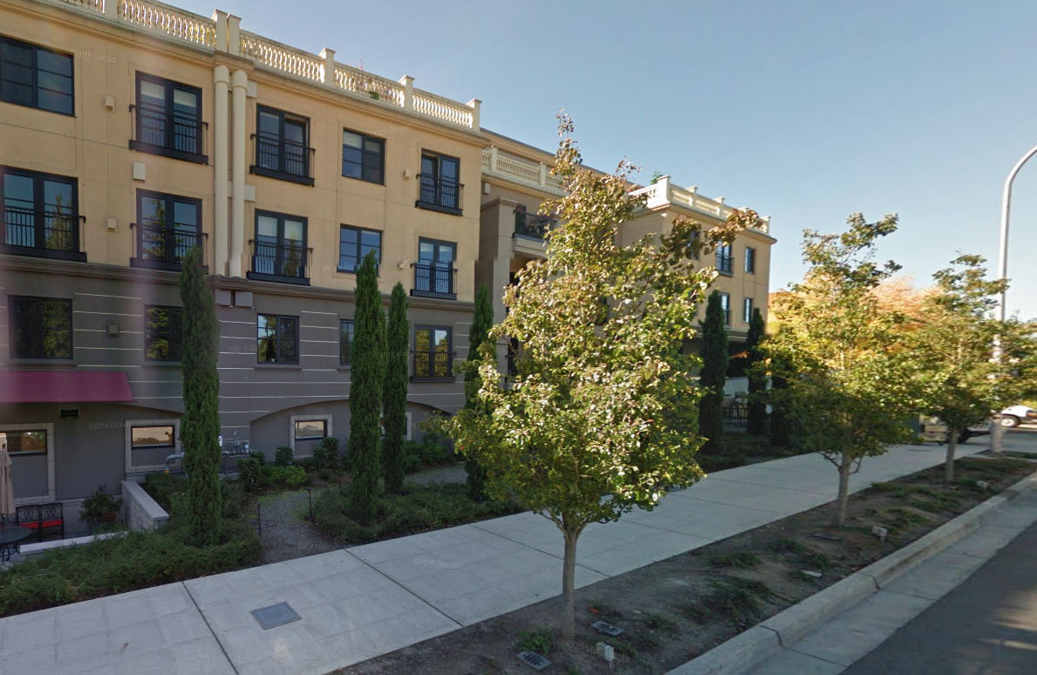
20-Foot Linear Buffer in Place
Example project: Bellettini, NE 12th Street
Example project: Sir Gallahad, Main Street

Slide 10
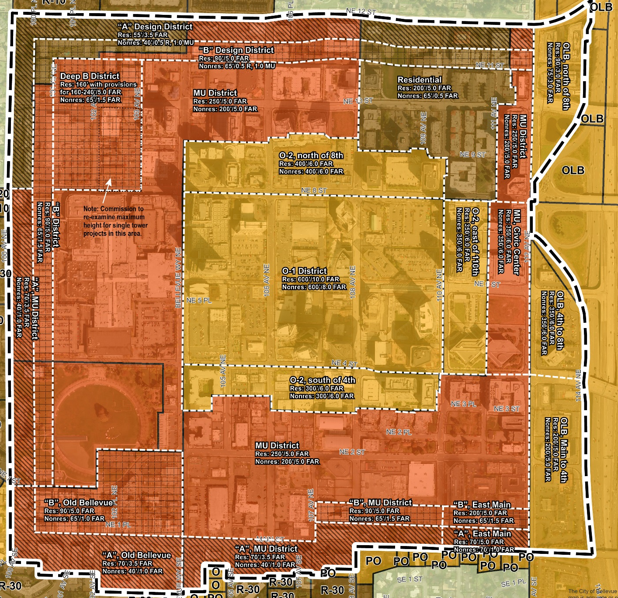
20-Foot Linear Buffer
Perimeter Overlay A-3

Slide 11
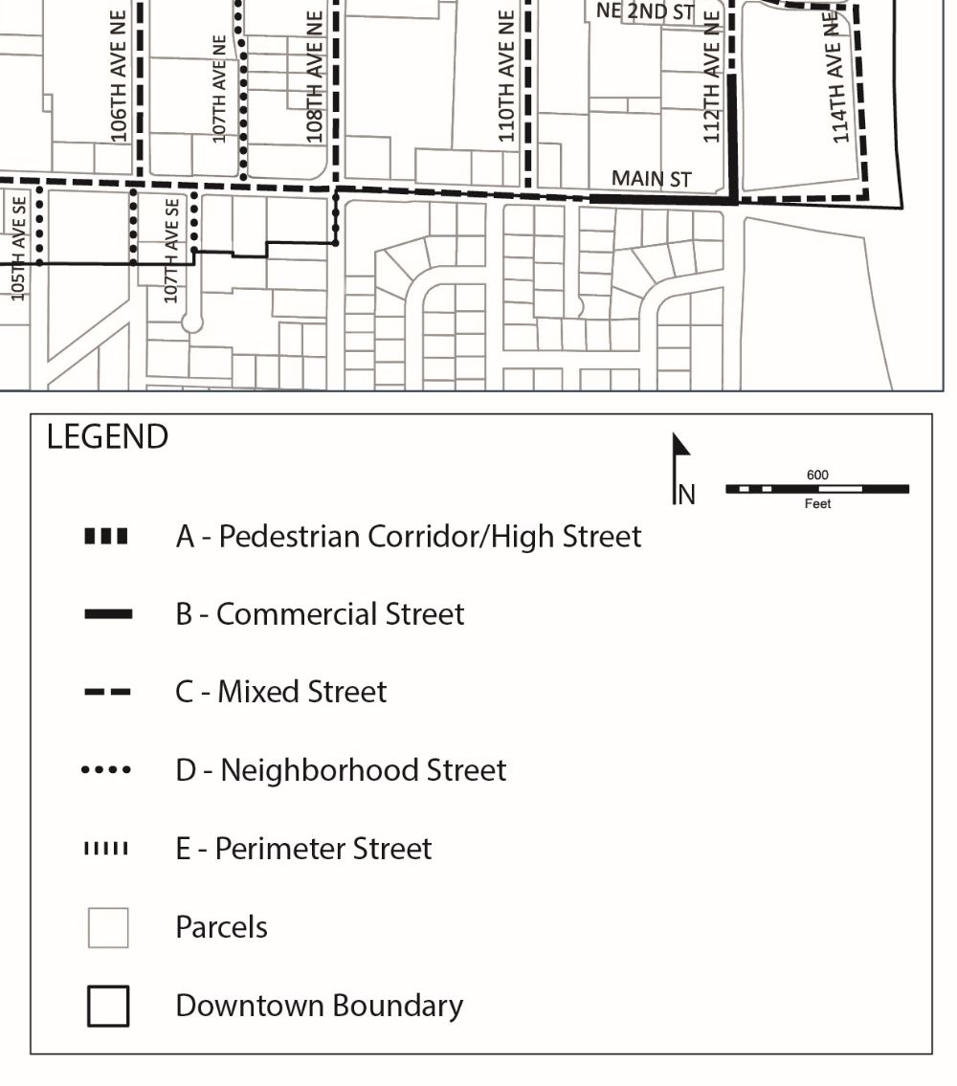
20-Foot Linear Buffer
Considerations Relative to Perimeter Overlay A-3
Adjacent to East Main Light Rail Station
Main Street in this area proposed to be designated as Commercial Street (50% pedestrian-activated frontage minimum; major point of interest every 75 feet of frontage)
16-foot sidewalks
Relationship to upper level building stepback per current code
BUILDING SIDEWALK RELATIONSHIP GUIDELINES
T

Slide 12
Single Tower Height in Perimeter Overlay B-2
Tonight – Commission direction regarding maximum building heights for single tower projects in Perimeter Overlay B-2 (Deep B District).
12

Slide 13
Perimeter Overlay B-2
Preliminary Commission Recommendation:
Multiple tower residential projects allowed 160-240 feet with a 200-foot average (plus 10% with interesting roof form, façade articulation).
Possible alternatives for area east of 102nd: (1) retain current recommendation of 160 feet; (2) use the 200-foot average for multiple tower projects; or (3) allow single tower projects the same maximum height as multiple tower projects of 240 feet.

Slide 14
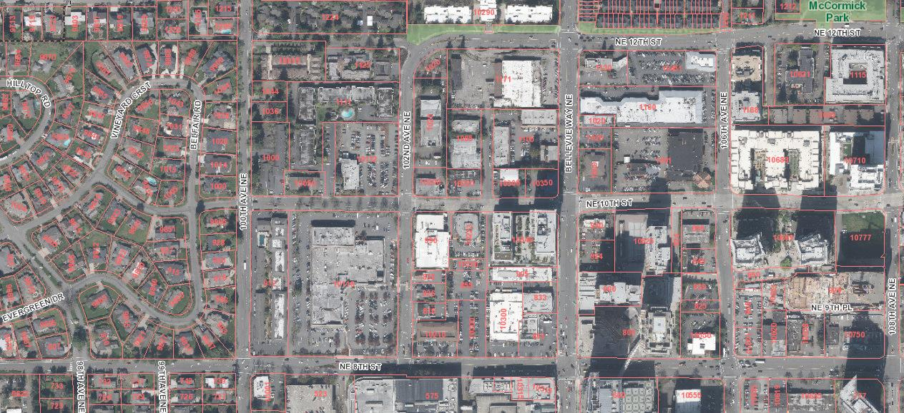
Perimeter Overlay B-2
West of 102nd: Two larger parcels under same ownership, ability to average multiple towers.
East of 102nd: Fragmented ownership, could potentially have 3-4 single tower projects. Also includes portion of Fortress development concept.
Considerations:
Lot sizes and ability to reach maximum height, proximity to adjacent single family neighborhoods, consistency with CAC recommendations relative to variable tower heights in this area.

Slide 15
Urban Land Institute (ULI) Technical Assistance Panel
Tonight – Staff overview of ULI Technical Assistance Panel for incentive modeling review to occur in December; answer Commission questions.
15

Slide 16
ULI Technical Assistance Panel
ULI Panel arranged for review of Incentive Zoning economic modeling based on Council interest
Provides expert third-party advice to local government entities and other organizations
Panelists to be selected by ULI Northwest from their membership base
Convene for about 1.5 days’ worth of meetings (targeting December 5 and December 15)
Panel will review work to be completed by Berk, consider stakeholder input, and ultimately form a set of recommendations for City consideration

Slide 17
Next Steps
Upcoming Meetings
  Nov. 9: Commission Input on Outstanding Downtown Code Issues
  Nov. 10 or Nov 17: Release of Installment 2b of Code Package (Design Guidelines, Process, Amenity List)
  Dec. 5: Tentative date for ULI Briefing
  Dec. 7: Commission Review of Consolidated Code Package
  Dec. 14: Commission Review of Consolidated Code Package
  Dec. 15: ULI Panel Day
  Q1 2017: Formal public hearing on the Consolidated Code Package including the Incentive Zoning System; Commission Deliberations and Transmittal to Council

Slide 18
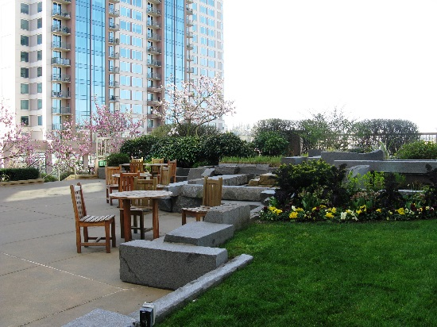
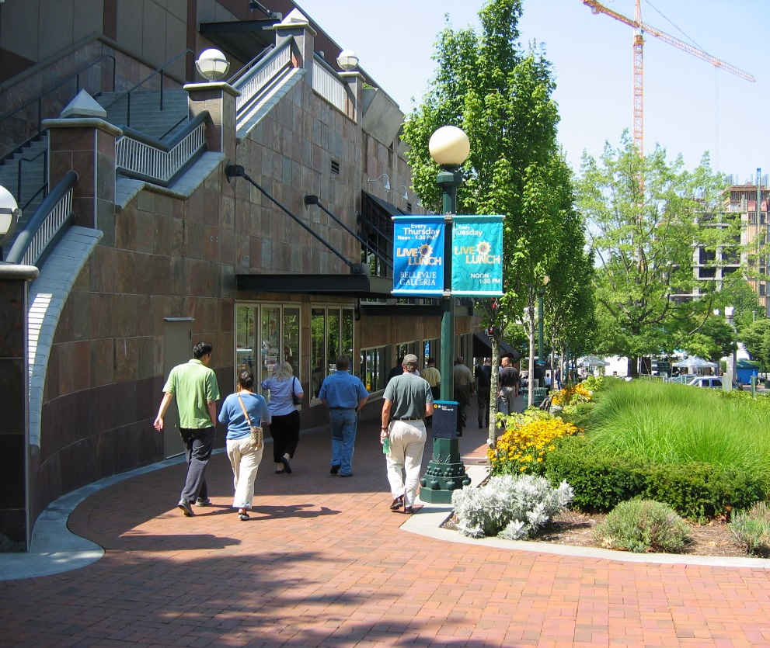
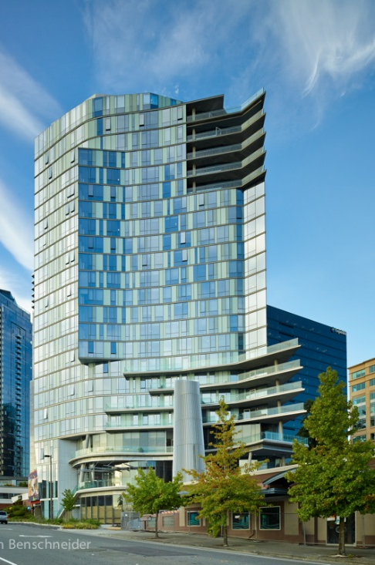
Downtown Livability
http://www.bellevuewa.gov/downtown-livability.htm
Emil King, Strategic Planning Manager, EAKing@bellevuewa.gov, 452-7223
Trish Byers, Code Development Manager, pbyers@bellevuewa.gov, 452-4241
18

