Slide 1
2016 Annual Comprehensive Plan Amendments Final Review Study Session
Bellevue Planning Commission
September 28, 2016

Slide 2
Notes:
Eastgate Office Park
Threshold Review recommendation basis of Council’s agreement to advance to Final Review
Potential overlooked with Eastgate LU&T Study
Significantly changed conditions from the intended changes in the subarea
14 acres 15325-15395 SE 30th Pl (note access) and 15400 and 15500 SE 30th (geographically expanded)
Eastgate Subarea: O to OLB
Potential Overlooked
Significantly changed condition of intended changes in the Eastgate area
Site was part of the Eastgate Study and these amendments have been adopted. If potential of this area was overlooked then there is no other ongoing venue for reviewing the designation of this site
Addresses significantly changed conditions of Eastgate process establishing OLB and OLB-2 designations allowing for mixed uses and TOD around the park and ride and additional policies.
TOD vs OLB-2 shift

Slide 3
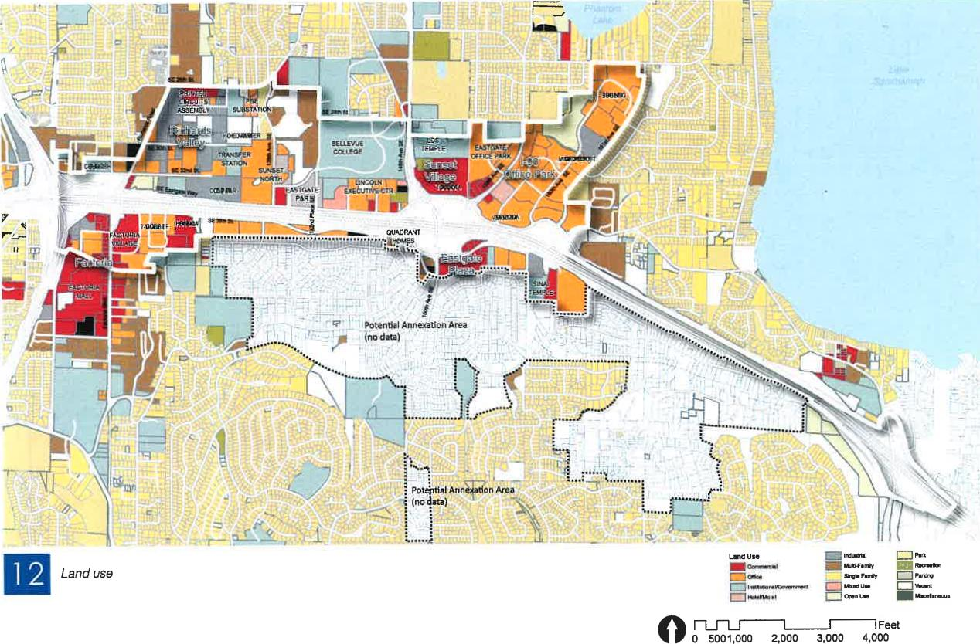
Eastgate/I-90 Project study area
Lend Use
t....eemi
multlFrriy &VOW, Had Ur OP." U.'
=m-
1WAIloi
Feet
0 0 5001,000 2,000 3,000 4,000
Notes:
Intended changes in the Eastgate area influencing significantly changed conditions:
OLB and OLB2 zoning potential
Additional policies adopted to increase mobility, access, and land use relationships to surrounding areas
A new focus on urban design
Allowing for more mixed uses
Establishment of TOD designation around Eastgate P&R

Slide 4
Goal to Outcome →→→→ CPAs
“To preserve and promote the accessibility and appearance of residential neighborhoods, local amenities, and business establishments within the Subarea.”
Eastgate Subarea Plan Goal, p. 123
Notes:
With such broad goals, how do we talk about site-specific proposals? Questions on agenda memo p. 2.

Slide 5
Thinking through policy analysis
Notes:
Flagging to begin conversation.
More on it later (macro).

Slide 6
Four part citywide vision and policy framework:
Land Use – focus on balancing growth in specific areas and maintaining the health and vitality of established neighborhoods
Transportation – focus on making moving into, around and through Bellevue reliable and predictable
Economic Development – clarity about the role that economics play in integrating land use and transportation.
Environment – embracing its stewardship of the environment by protecting and retaining natural systems, and building for a sustainable future.
Notes:
See also Attachment 4

Slide 7
Eastgate/I-90 Land Use and Transportation Project policy themes
Create a coherent image in the I-90 corridor through design that includes elements of naturalistic landscaping, ecological enhancement and urban design
Encourage a greater mix of uses in office and commercial areas to provide goods and services in closer proximity to businesses, workers, and neighborhoods
Allow more intense office and commercial development in exchange for additional public amenities
Support all transportation modes to improve connectivity and reduce auto trips

Slide 8
Eastgate Subarea Plan
The Eastgate Subarea Plan (p. 124): “In 2012, the Eastgate/I-90 Land Use and Transportation Project was completed…The project supports changes intended to capture market demand, improve transportation conditions, address concerns of the employment sector as well as the general public, and position the corridor to grow gracefully over time.”
The key elements:

Slide 9
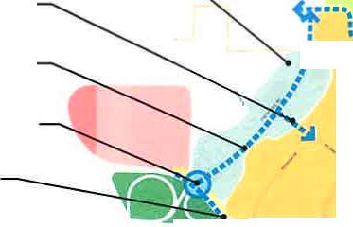
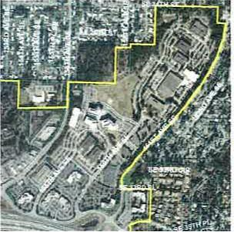
Protect Phantom Lake watershed.
Encourage ground floor local-serving conveniences and amenities and residential and office on upper floors.
Implement Airfield Park project.
NelVd ]Oldd0 06
Improve trail with asphalt surface.
Provide a walkway for pedestrians.
Add bike shoulders or lanes.
Improve intersection for future traffic volumes.
=it
r
••
Provide pedestrian connections and improve outdoor
space for office workers' use. Allow more intense development in future with ground floor services.
Add bike lanes to Eastgate Way.
Commercial with residential Office with retail Future Airfield Park
.> Non-motorized Improvement
0 Intersection Improvement p Green 1-90 right-of-way Gateway
Eastgate CAC Final Report Appendix A
"Z-L-71•••••"⁴•...
-; •)... 0
are pleasantly landscaped but there are few pedestrian connections stitching the individual buildings into a comprehensive unit. However, the development of the future park at the Bellevue Airfield site will provide additional recreation space and activity to this part of the study area, and will provide opportunities for connectivity to other open spaces including Robinswood Park.
Other than development of the future park, the most effective short term improvement action is to provide pedestrian connections through the parking lots and improve some pedestrian oriented outdoor spaces in which workers could picnic and relax. Greater connectivity and access might add to the viability of small services such as a coffee shop or delicatessen. These connectivity improvements will help
facilitate access to the Eastgate Area Park being developed adjacent to 1-90 Office Park Complex.
ATTRIBUTES AND STRATEGIES
Enhance connections and streetscapes that link the 1-90 office park complex to retail, services, and transit on 156th Avenue SE.
Enhance the active transportation benefits of improved pathway connections to the Eastgate Area Park project to help create more livable communities.
Enhance bicycle access through the area with a bike shoulder on 156th Avenue SE from SE 27th Street to SE Eastgate Way. Add bike lanes on SE Eastgate Way.
Improve the underpass to Eastgate Plaza to support pedestrian and bicycle circulation.
Protect and enhance aquatic systems of Phantom Lake drainage.
Improve the pedestrian environment along Eastgate Way.
Existing conditions
Eastgate / 1-90 Land Use & Transportation Project 53
Notes:
Intended changes in the Eastgate area:

Slide 10
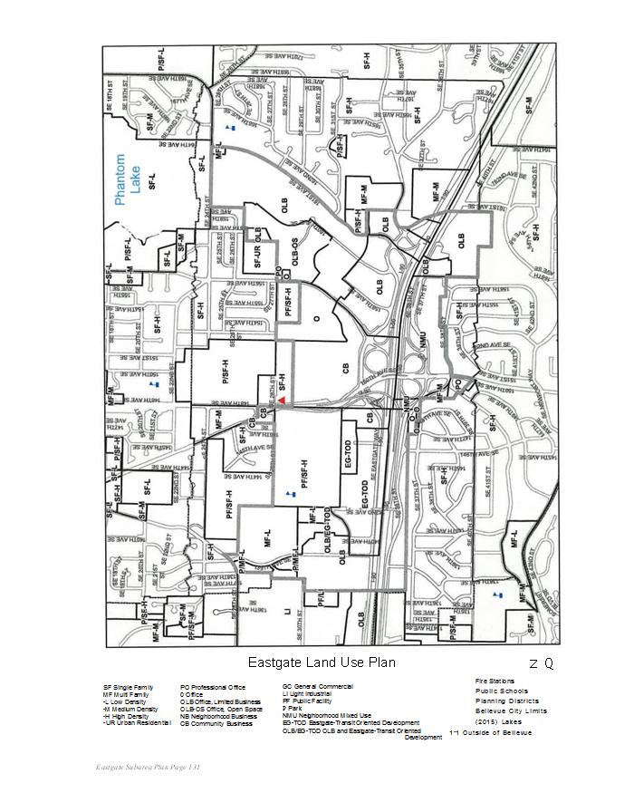

Slide 11
Policy Discussion questions and strategies
How do these visions and strategies apply to this site-specific CPA?
2. What are the Commission’s perspectives on balancing competing priorities?
3. How should trade-offs be considered?
4. What types of info may be needed for the Commission?

Slide 12
2016 Annual Comprehensive Plan Amendments Final Review Study Session
Bellevue Planning Commission
September 28, 2016

